Slide 1
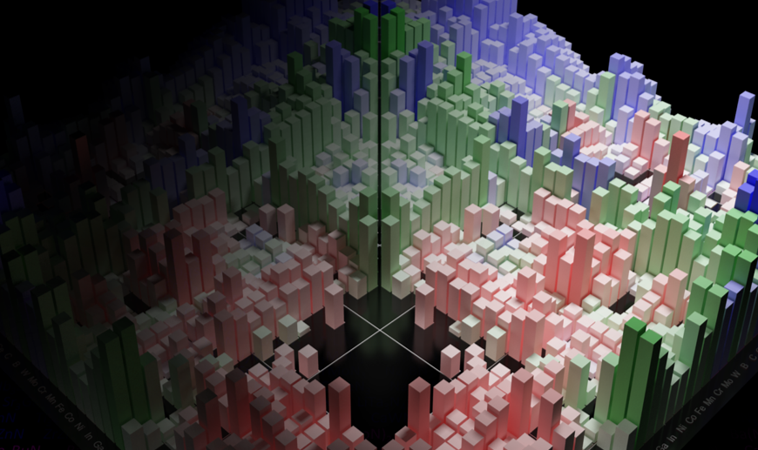
MSE 593 Data-Driven Materials Design and Genomics
Data-Driven Computational Materials Design:
A tutorial on modern materials informatics
Professor Wenhao Sun whsun@umich.edu
2023 Summer School for Integrated Computational Materials Education
Notes:
Syllabus Wenhao Sun
Set up Canvas – Katsuyo
Google Survey – Katusyo

Slide 2
Cross-Industry Standard Process for Data Mining
(CRISP-DM)
Materials
Lecture 4

Slide 3
Materials Science and Engineering Version
of Crisp-DM
Before you start a data-project in MSE, ask yourself
Materials
1. What dataset will you use?
- Will you create your own data or access a database?
- What is the form of the data? Numbers? Images? Plots?
2. What is the most interesting question you can ask this dataset?
3. Is the representation of the data amenable
to the question you are trying to answer?
The most important thing for a successful data project is a well-poised hypothesis.

Slide 4
Materials Science and Engineering Version
of Crisp-DM
Materials
55%: Data Collection and Data Preparation
40% Analysis/Interpretation
5% Machine Learning

Slide 5
Expertise from your materials science and engineering major
Countless online tutorials
55%: Data Collection and Data Preparation
40% Analysis/Interpretation
5% Machine Learning

Slide 6
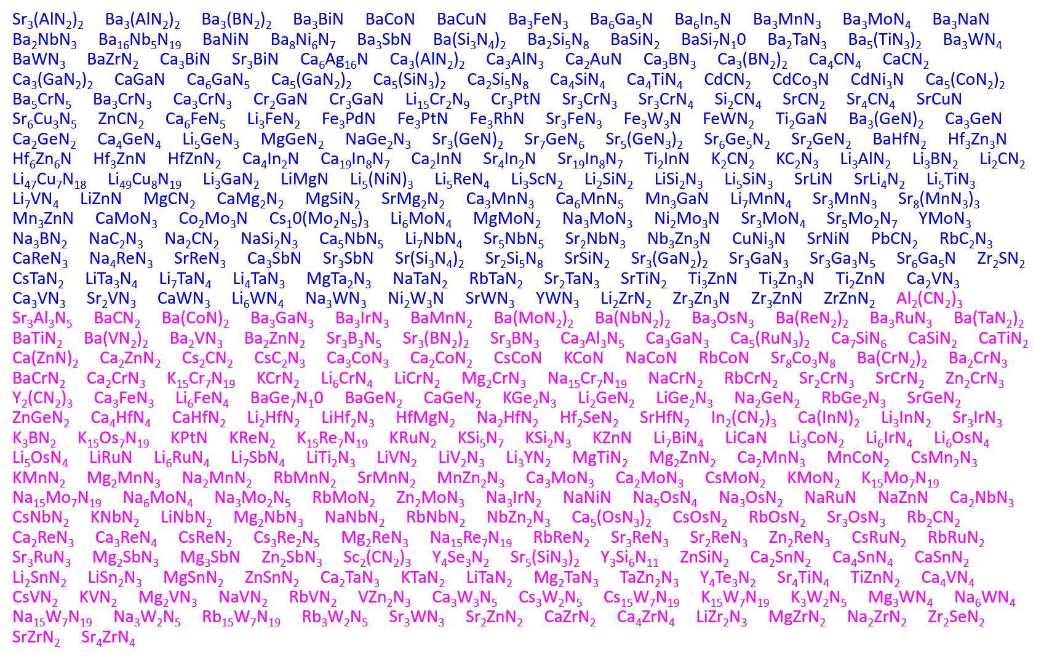
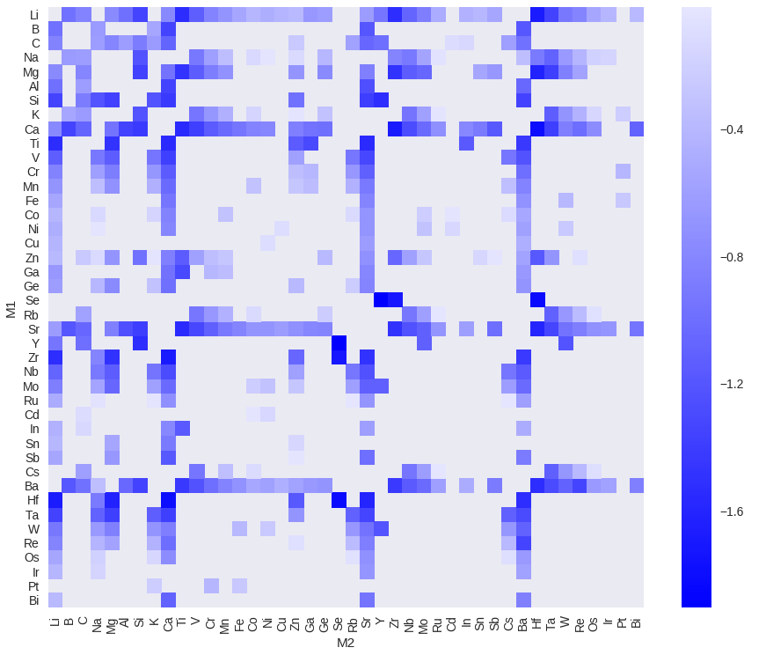
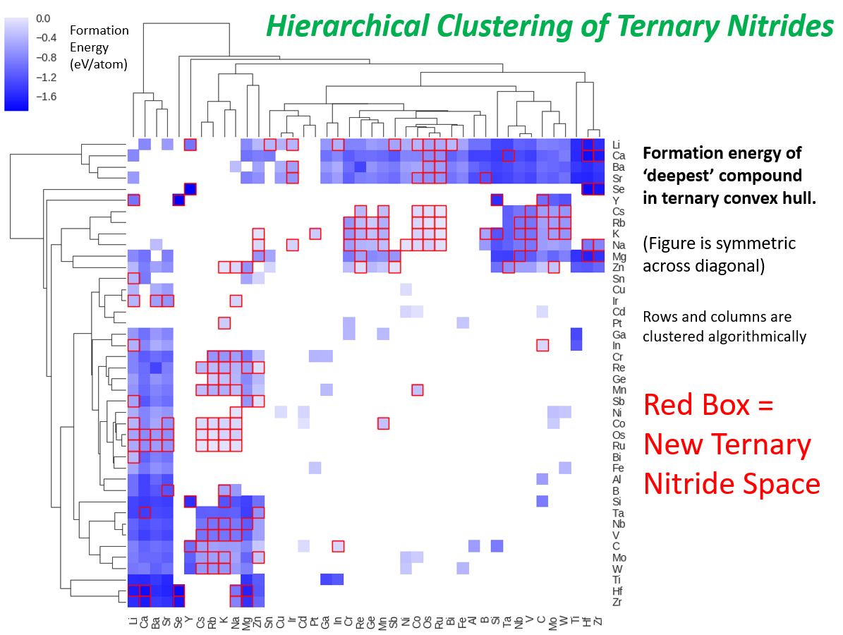
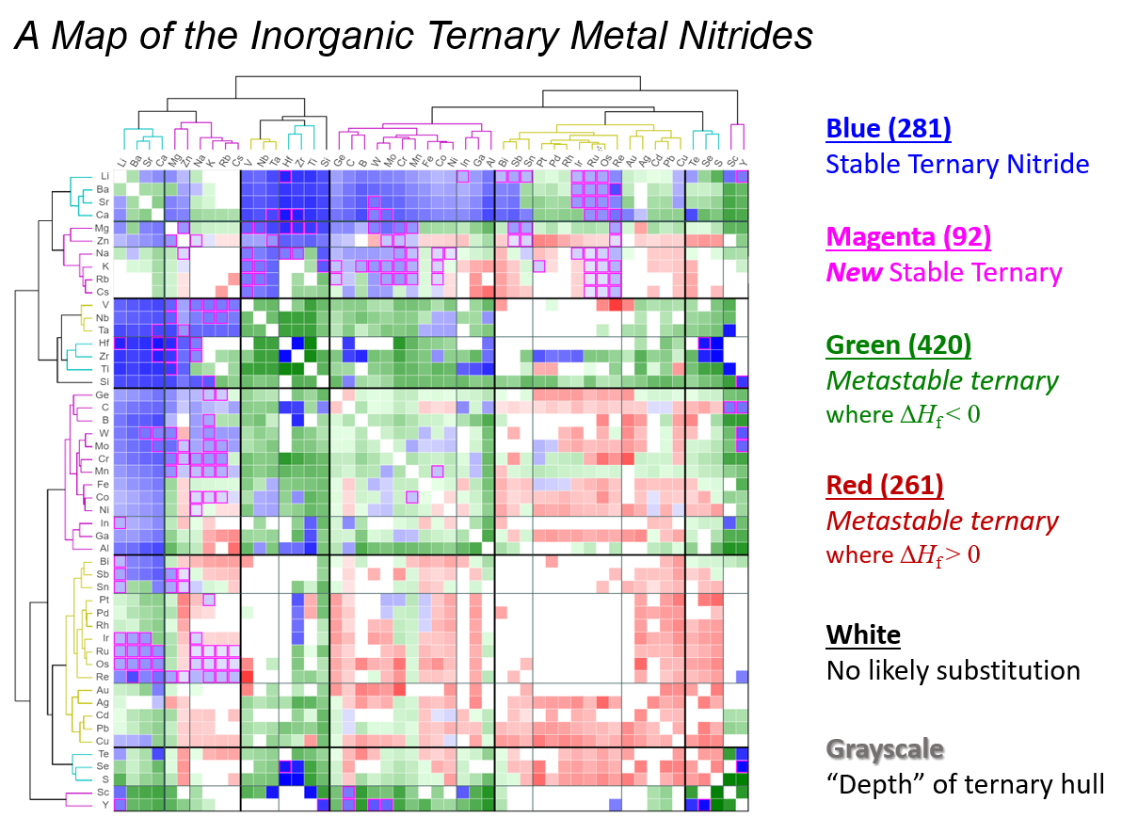
A list of new stable nitrides
calculated in DFT
Data Exploration
“A map of the inorganic ternary metal nitrides”
W. Sun et al., Nature Materials (2019)

Slide 7
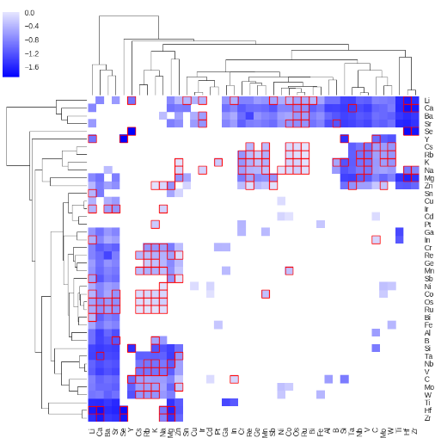
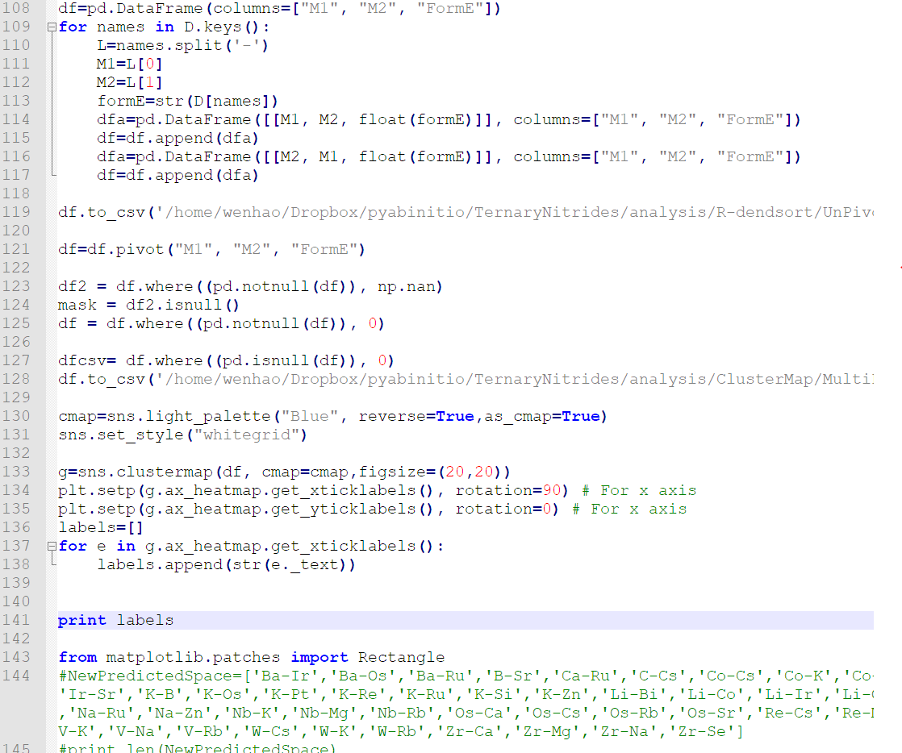
Setting up the Data
Machine-Learning
Preparing for Analysis
55%: Data Collection and Data Preparation
40% Analysis/Interpretation
5% Machine Learning

Slide 8
Materials
A brief introduction to Machine-Learning
Analysis
Inductive
vs.
Deductive

Slide 9
Inductive
Deductive
Prepare Dataset
Identify Patterns
Formulate hypothesis
Develop Theory
Inspired from Theory
Construct Hypothesis
Prepare Dataset
Confirm theory in dataset
Exploratory in nature
Underlying relationships in the dataset are not known a priori
Machine-learning models can be used to explore relationships
The dataset may not have the proper features to explain a specific phenomenon.
Targeted investigation
You have a preconceived relationship in mind, based on domain knowledge or experience.
You are testing your hypotheses against a large dataset.
You may need to make or derive new features to create the necessary dataset.

Slide 10
Inductive
Prepare Dataset
Identify Patterns
Formulate hypothesis
Develop Theory
Split data into categories
Fit a model to your data
Categories can help
distinguish between
materials, parameters,
properties, etc.
A model can be used to
interpolate or extrapolate
your data
An analytical model can be
interpreted
Considerations
Is your data in a quantitative form?
What features should you consider for the axes?
Which axes do you plot against which?
Is the ‘dashed line’ linear? More complicated?

Slide 11
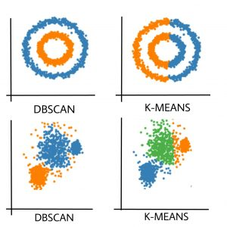
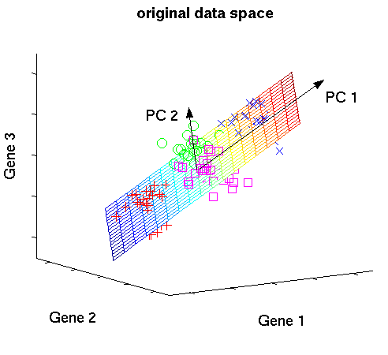
Clustering
Dimensionality Reduction

Slide 12
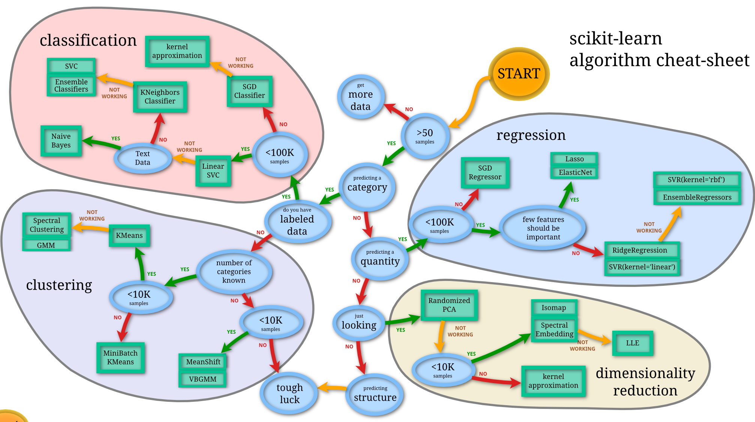

Slide 13
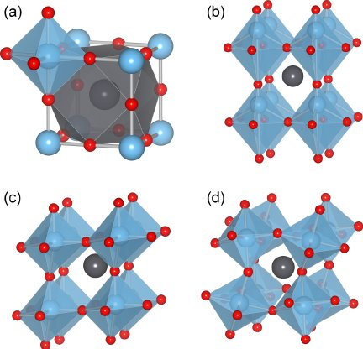
Considerations
Is your data in a quantitative form?
What features should you consider for the axes?
Which axes do you plot against which?
Is the ‘dashed line’ linear? More complicated?
Deductive or Inductive?
Classification or Regression?
We are designing high-entropy metal alloys, which have 5-elements in the compound. We are searching for HEA compositions that have good corrosion resistance.
How does crystal structure and chemistry lead to a direct vs. indirect band gap in a semiconductor?
We are trying to find new superhard coating materials for wear-resistant applications. Which chemical spaces are promising?
Perovskites are often distorted from their cubic form. We have a large collection of XRD patterns for known perovskites. How can we tell if a future XRD pattern shows a pristine or distorted perovskite?

Slide 14
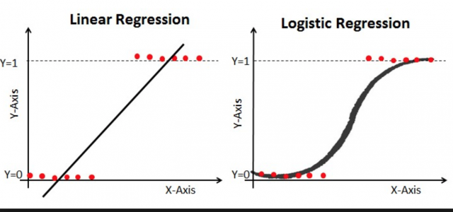
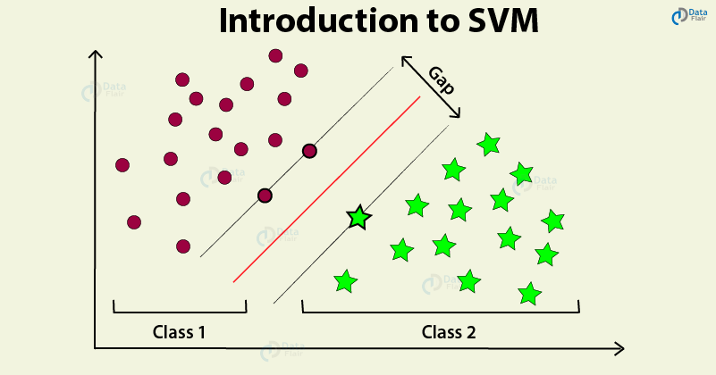
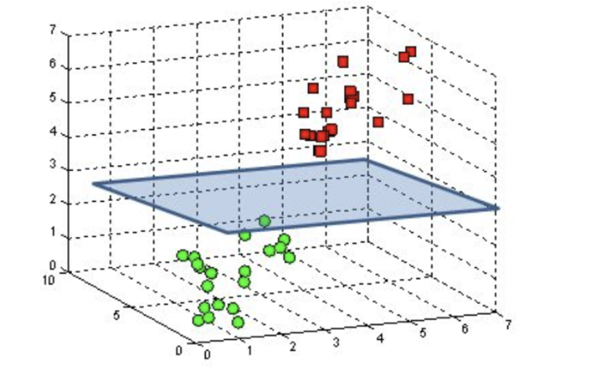
The separating line (kernel) can also be non-linear.

Slide 15
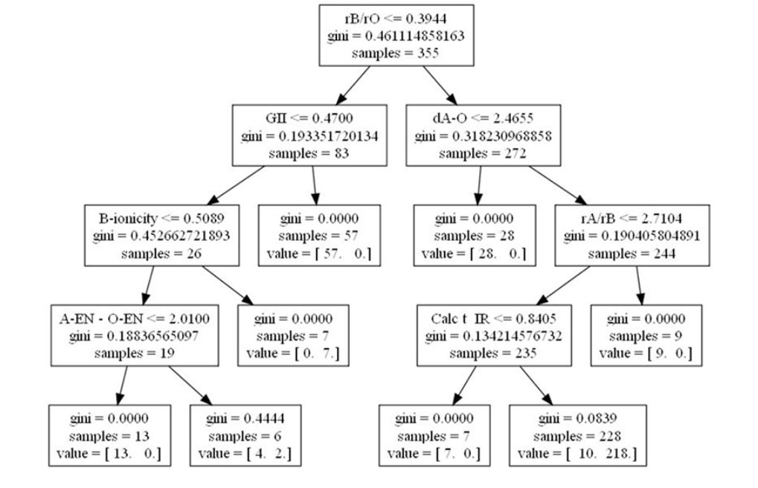
Decision Tree
Multiple Decision Trees = “Random Forest”

Slide 16
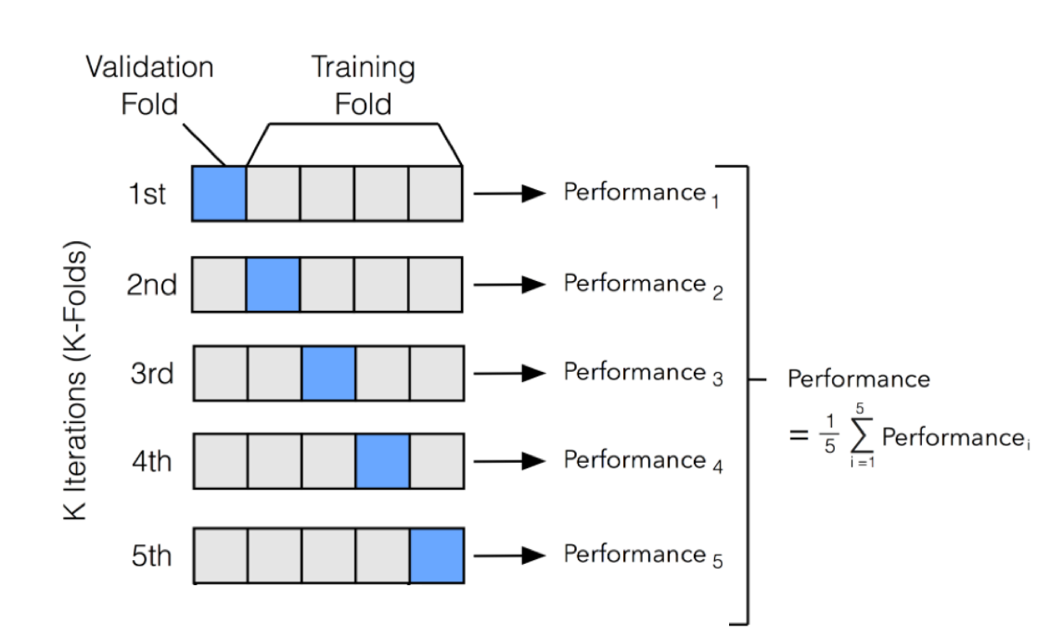
Evaluating predictor performance:
K-fold cross validation

Slide 17
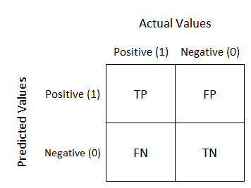
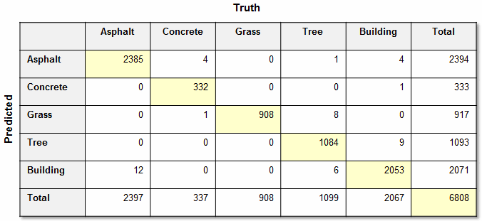
Confusion Matrix
Evaluates the quality of your classifier

Slide 18
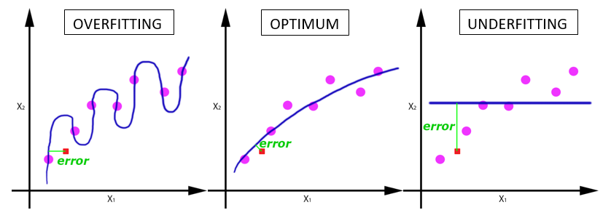
Higher prediction score is not always better in
complex models
Make sure there are no ‘interdependent’ features
(Don’t have data for volume and mass if you are predicting density.)
A coarse model with high interpretability is more valuable than a ‘perfect’ model with low interpretability.

Slide 19
Be careful when ‘Hyperparameter Tuning’:
My trees could have hundreds of levels and hundreds of branches, which would give me great classification performance. Definitely overfit!
A coarse model with high interpretability is more valuable than a ‘perfect’ model with low interpretability.

Slide 20
Suppose I am predicting high T_{c} superconductors
99% of materials are not high T_{c} (>60 K) superconductors.
An algorithm that always predicts ‘not high T_{c} superconductor’
will have 99% performance!
→ Resample the dataset to balance True / False entries
→ Add penalties for misclassification.

Slide 21
Suppose I am predicting synthesis recipes from a synthesis database
If the database only has successful syntheses, then
there are no ‘negative’ datapoints to make a classifier!
Can use proxies for ‘complicated’ or ‘simple’ recipes. If a reported recipe is complicated, then a simple approach probably didn’t work.

Slide 22
Suppose I am classifying high T_{c} superconductors
Most high Tc superconductors are cuprates
(contain a CuO₂ sheet)
If cuprates were never discovered, could you have
‘machine-learned’ its existence?
→When doing cross-validation, be careful not to sample the data randomly. You should leave one ‘cluster’ out.

Slide 23
Feature Selection
A good descriptor:
should be simpler to determine than the target property itself
should be as low-dimensional as possible (scalars are better than vectors)
should uniquely characterize a material
Use the right scale:
Example: fitting log(diffusivity) might be better than fitting absolute diffusivity.
Regularize properly: Some ML algorithms do not work well if one parameter varies from 0-1 and another from -100 to 100

Slide 24
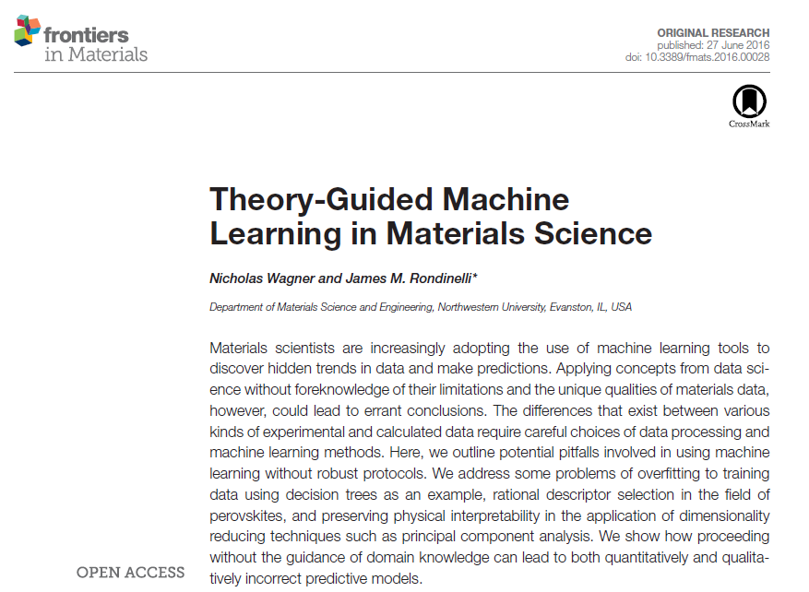

Slide 25
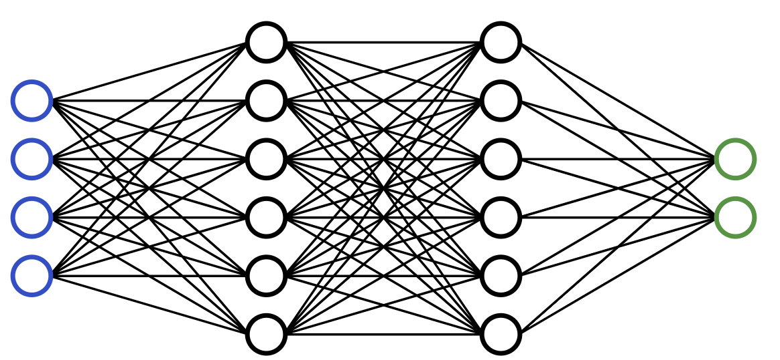
Unsupervised knowledge discovery in ‘big’ materials data
‘Hard to get’ data →
DFT calculations
AIMD simulations
Expt. Measurements
Hand-labeled data
Machine Learning →
Approximate ‘data’ faster
Predict bandgaps / energies
Longer/Bigger MD sims.
Interpret expt. faster
Great engineering value
More screening, longer simulations, extrapolate models
Lacks interpretability
Hard to extract scientific insights

Slide 26
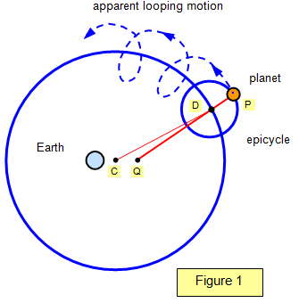
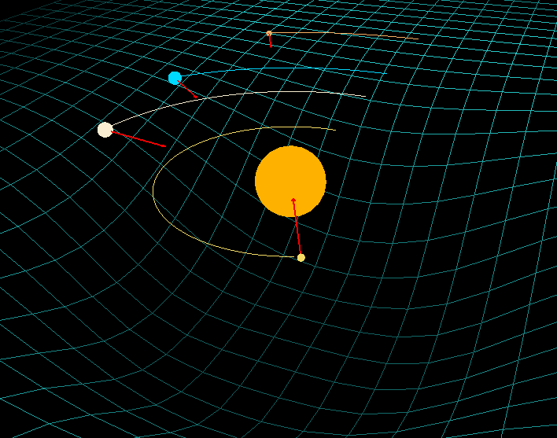
Unsupervised knowledge discovery in ‘big’ materials data
Ptolemy’s Epicycles
Newtonian Gravity
Machine-Learned Regression
+ Accurate Predictions
- No knowledge discovery
Physically-Motivated Theory
+ Accurate Predictions
+ Conceptual Understanding

Slide 27
Unsupervised knowledge discovery in ‘big’ materials data
Machine-Learning
Machine-Teaching
ML algorithms need to frame their learned insights within ‘our interpretation’ of science
It is the materials scientist, armed with ML and data-tools,
who will discover new fundamental knowledge from big data

