Slide 1
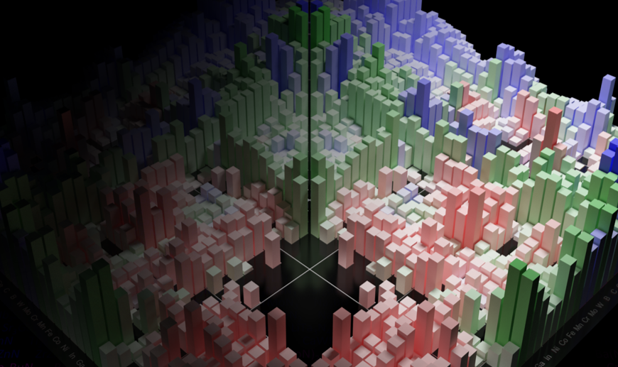
MSE 593 Data-Driven Materials Design and Genomics
Data-Driven Computational Materials Design:
Lecture 3: Using the MaterialsProject API
Professor Wenhao Sun whsun@umich.edu
2023 Summer School for Integrated Computational Materials Education
Notes:
Syllabus Wenhao Sun
Set up Canvas – Katsuyo
Google Survey – Katusyo

Slide 2
https://whsunresearch.group/hss_2023
Download Lecture 3 Python Notebook

Slide 3
Cross-Industry Standard Process for Data Mining
(CRISP-DM)
Materials
Lecture 3+4

Slide 4
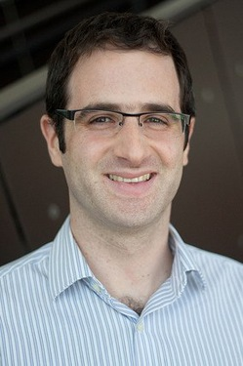
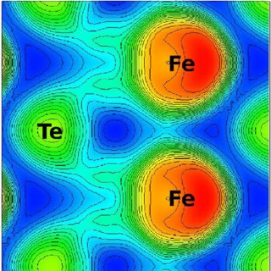
Professor Kioupakis asked me:
“I hypothesize that ionic oxides with high atomic density will have strong overlap of atomic orbitals, which will be correlated with a larger band gap.”
How might we explore this?

Slide 5
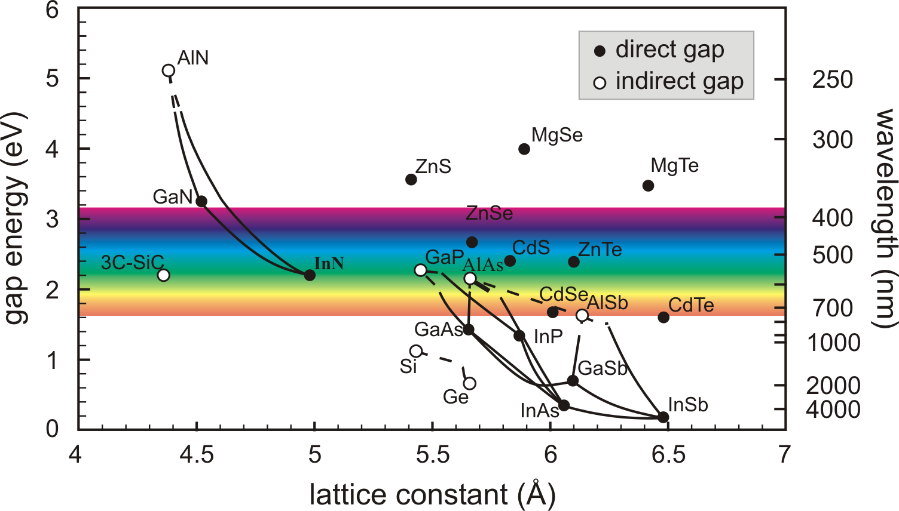
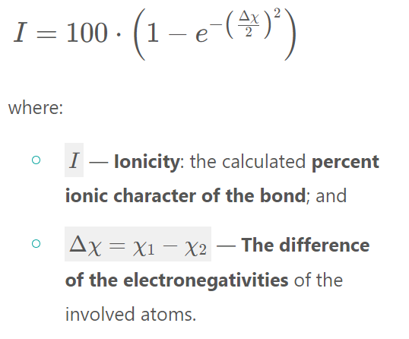
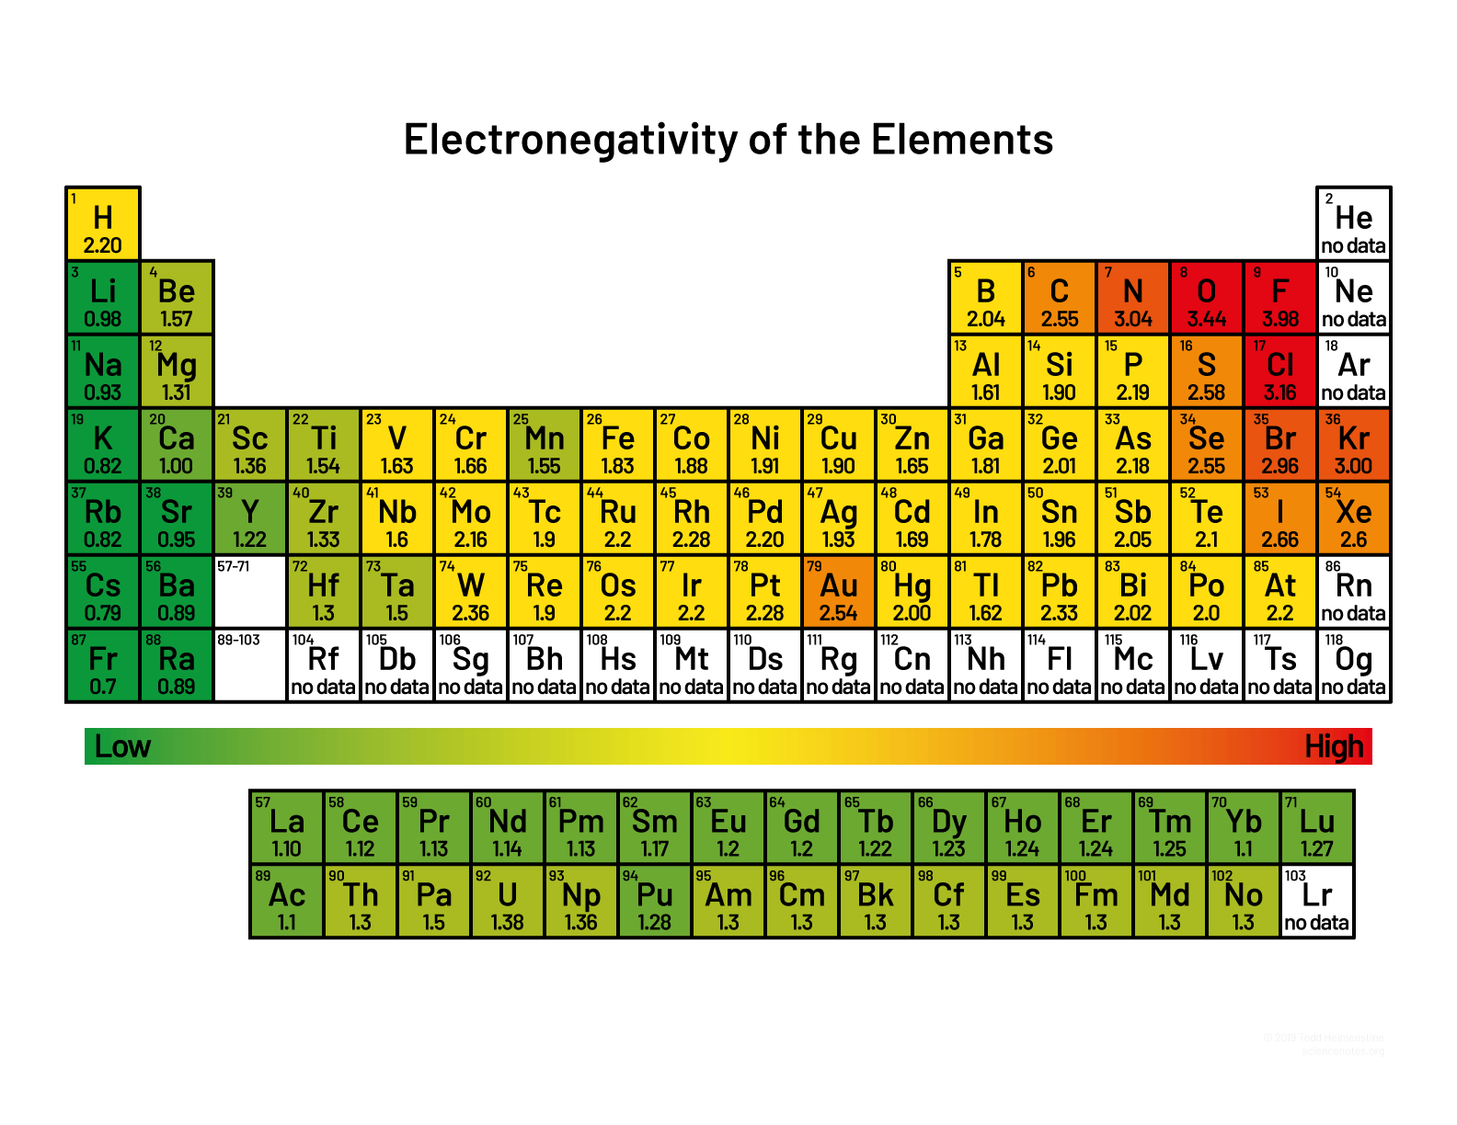
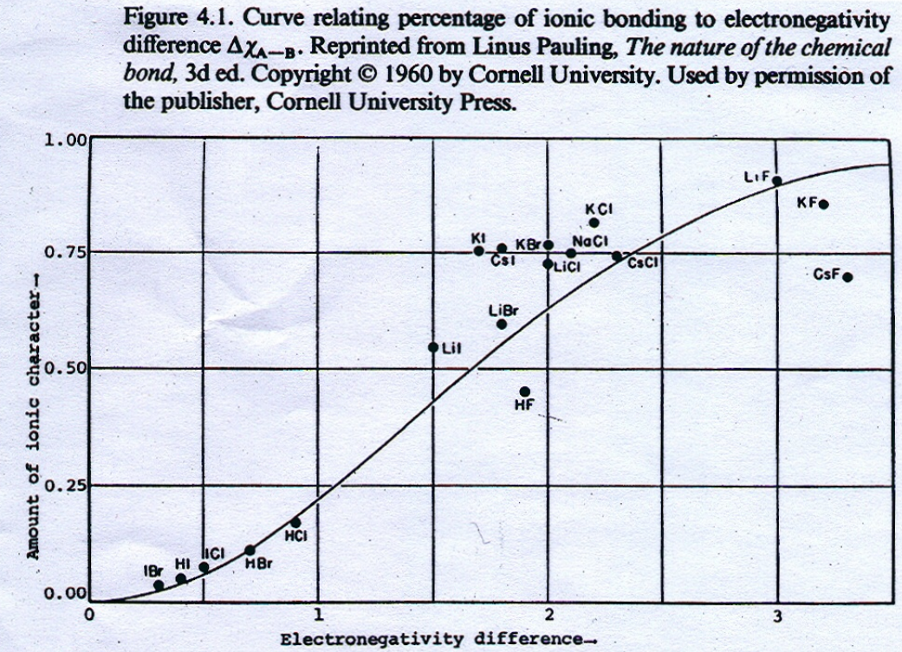

Slide 6
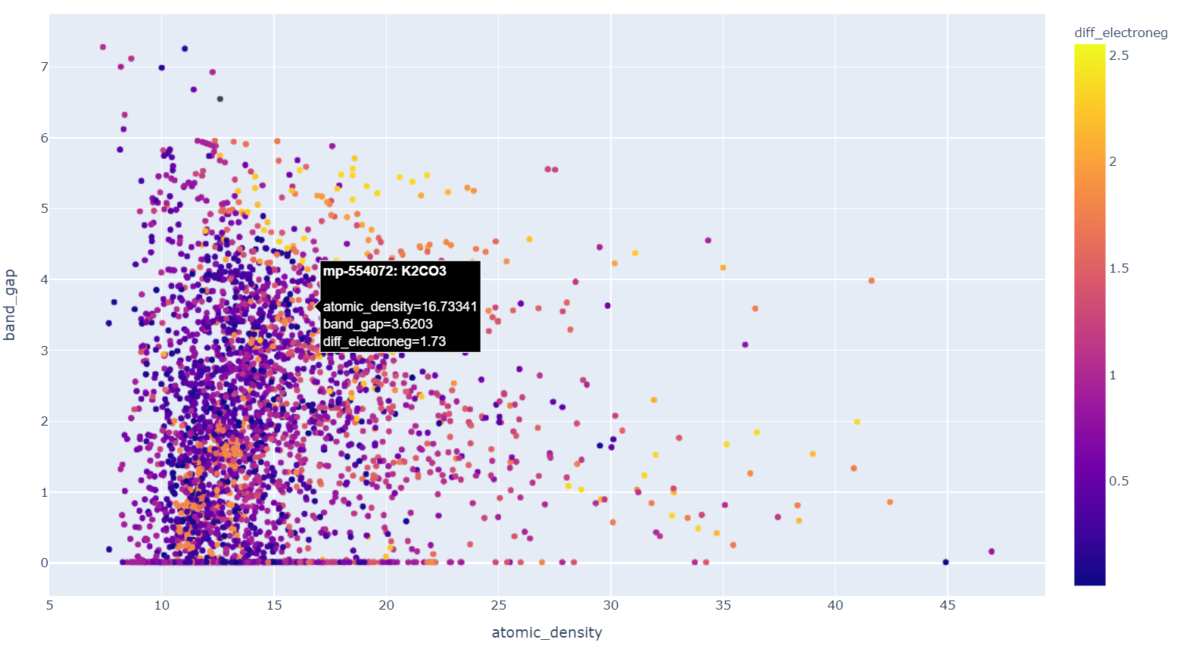

Slide 7
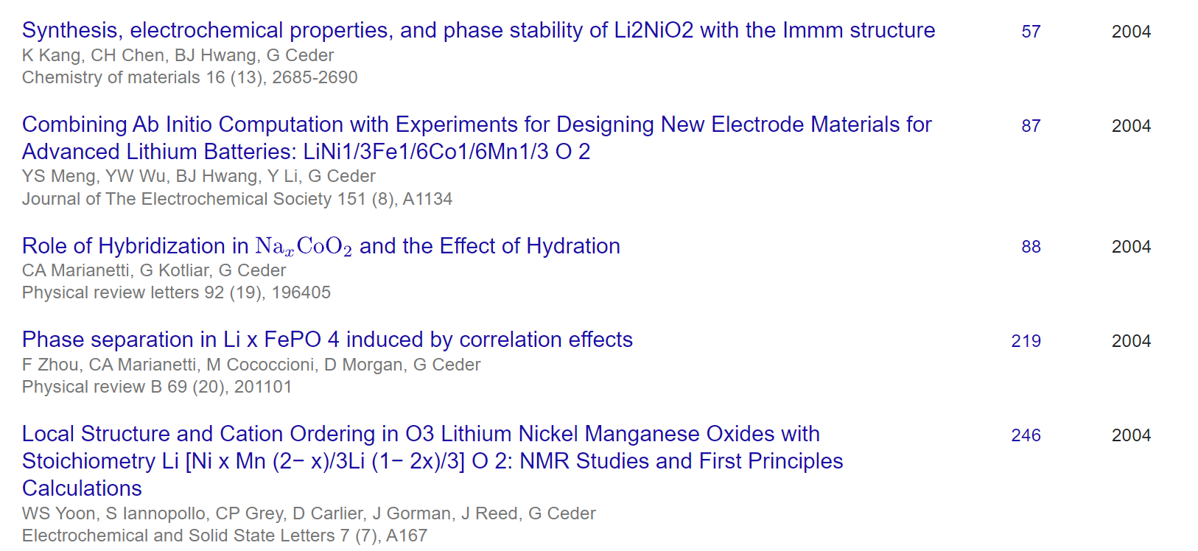
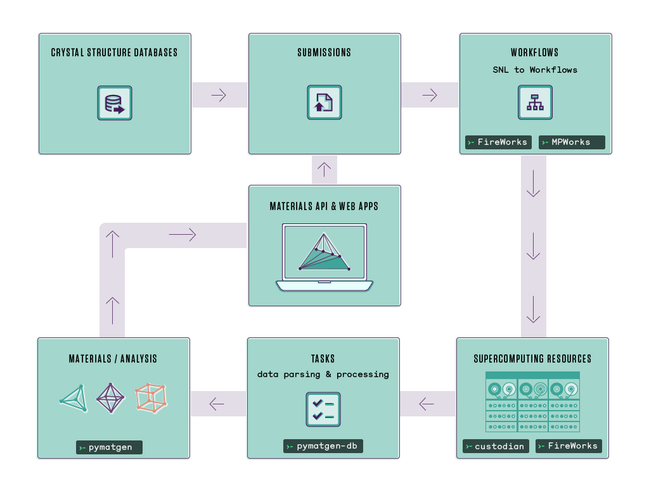
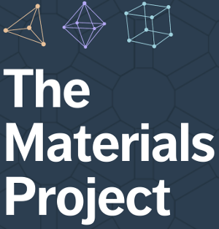
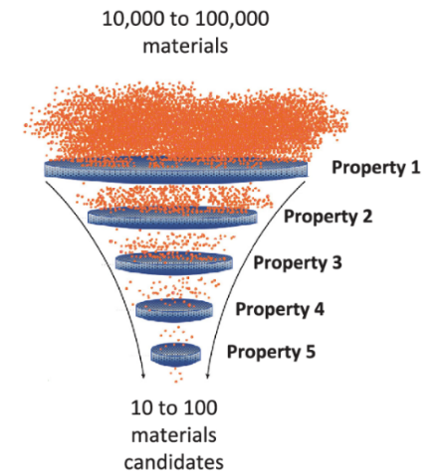
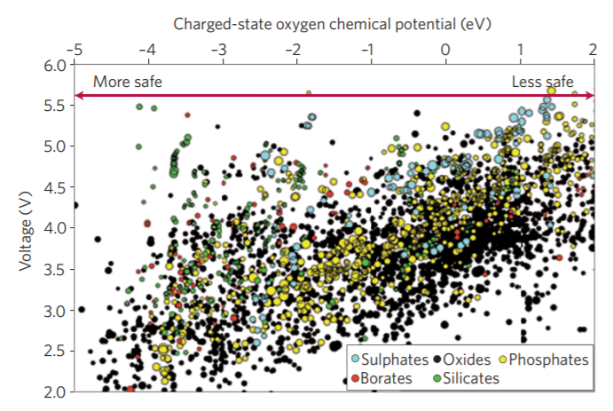
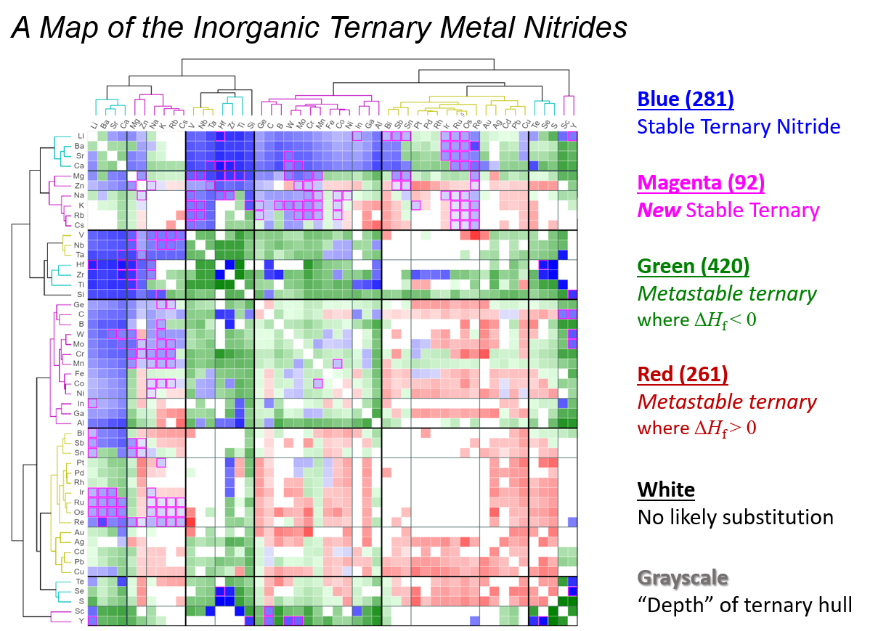
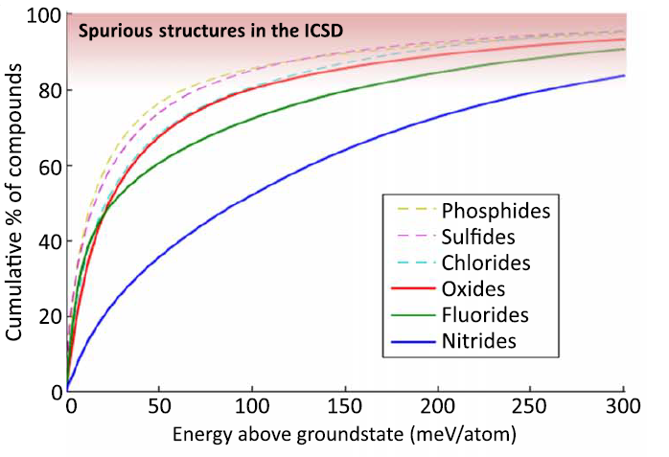
Before 2010 – DFT studies on single materials systems
2011 – Materials Genome Initiative, Materials Project
For Loop
Today
It’s not just ‘more’ data, you can do a different kind of science:
1400 data points
30,000 data points
6,000 data points
Materials Search
Fast prototyping and Broad hypothesis testing
Quantitative statistics
Visualize broad chemical trends

Slide 8
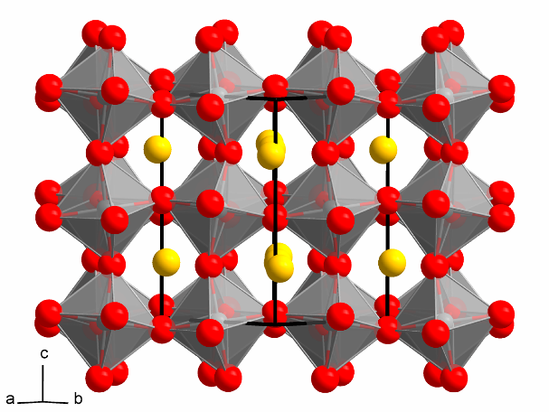
PYMATGEN QUERIES
How to execute a query:
entries = MPR.query(criteria=criteria, properties=props)
Search criteria
Calculated material properties
Example criteria:
must have ABC₃ stoichiometry
must contain oxygen
must contain either Li, Na, or K
must have band gap > 1 eV
Example properties:
chemical formula
band gap
band structure
CaTiO₃
(perovskite structure)
https://docs.mongodb.com/manual/reference/operator/query/

Slide 9
Materials Project API (Application Programming Interface)
anonymous_formula
band_gap
band_structure
blessed_tasks
bond_valence
chemsys
cif
cifs
created_at
delta_volume
density
diel
doi
doi_bibtex
dos
e_above_hull
efermi
elasticity
elasticity_third_order
elements
encut
exp
final_energy
final_energy_per_atom
formation_energy_per_atom
formula_anonymous
full_formula
has
has_bandstructure
hubbards
icsd_ids
initial_structure
input
is_compatible
is_hubbard
is_ordered
last_updated
magnetic_type
magnetism
nelements
nkpts
nsites
ntask_ids
original_task_id
oxide_type
pf_ids
piezo
pretty_formula
pseudo_potential
reduced_cell_formula
run_type
snl
snl_final
spacegroup
structure
task_id
task_ids
total_magnetization
unit_cell_formula
volume
warnings
xrd

Slide 10
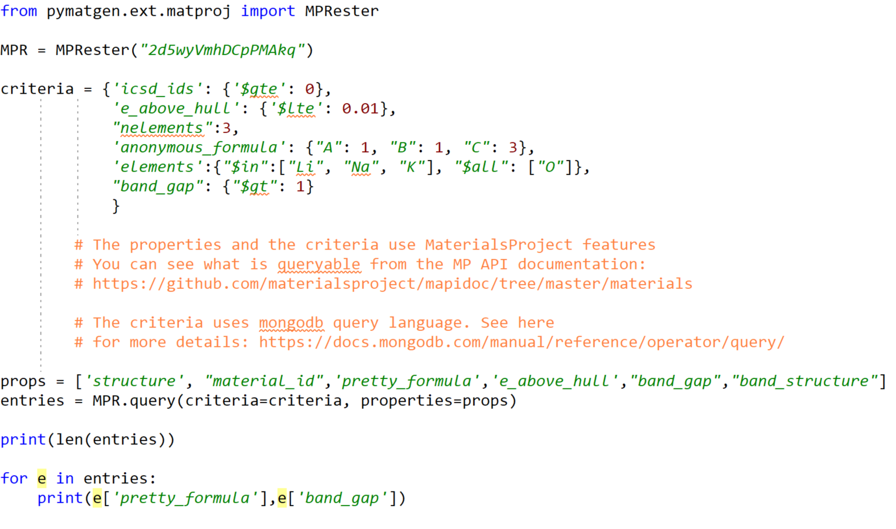
Install Pymatgen
https://pymatgen.org/installation.html
MPRester = Materials Project API
criteria = What you will query for
https://github.com/materialsproject/mapidoc
To see available features
Uses Mongodb query language
props = What you want to have returned

Slide 11
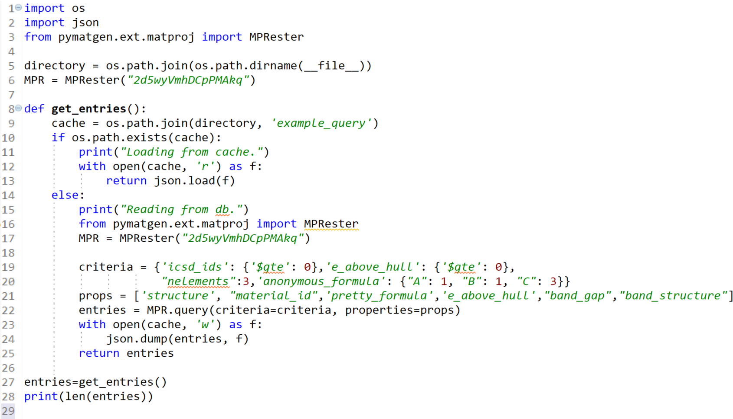
cache = local file
If cache exists, load cache
Else, do the query and save the cache

Slide 12
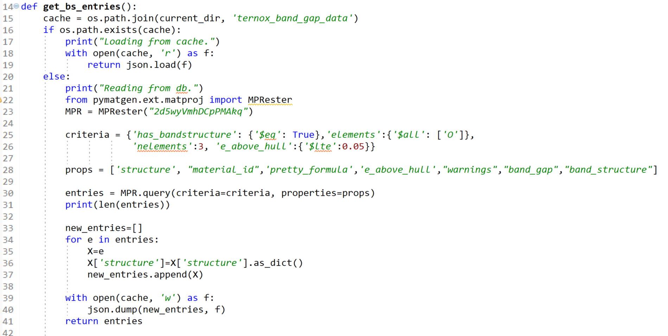
What are we querying here?

Slide 13
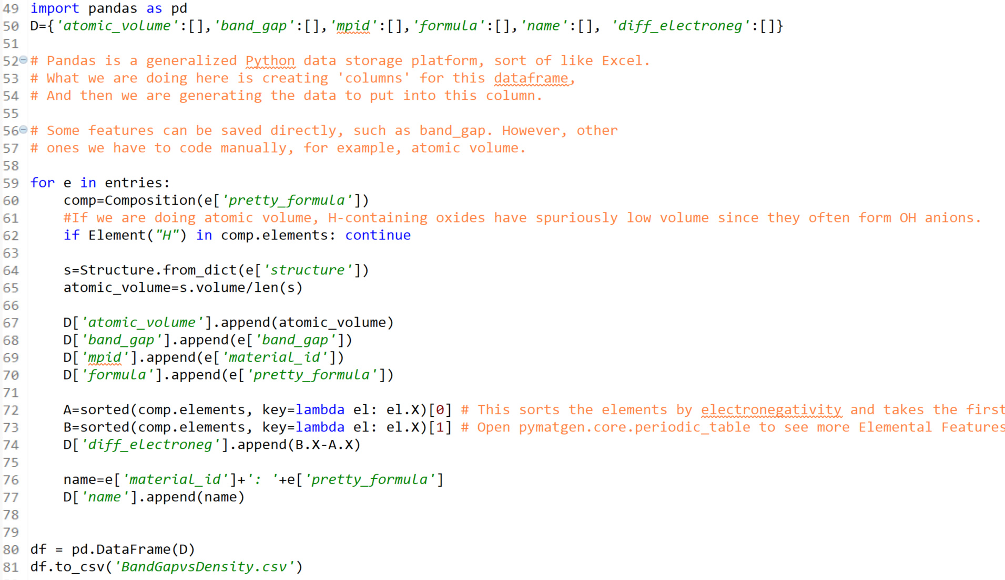
Initialize a pandas dataframe
Populate dataframe with values
For features like electronegativity, read pymatgen and mapidoc manual
Plot data, use ML, etc.

Slide 14
Materials Science and Engineering Version
of Crisp-DM
Materials
55%: Data Collection and Data Preparation
40% Analysis/Interpretation
5% Machine Learning

Slide 15
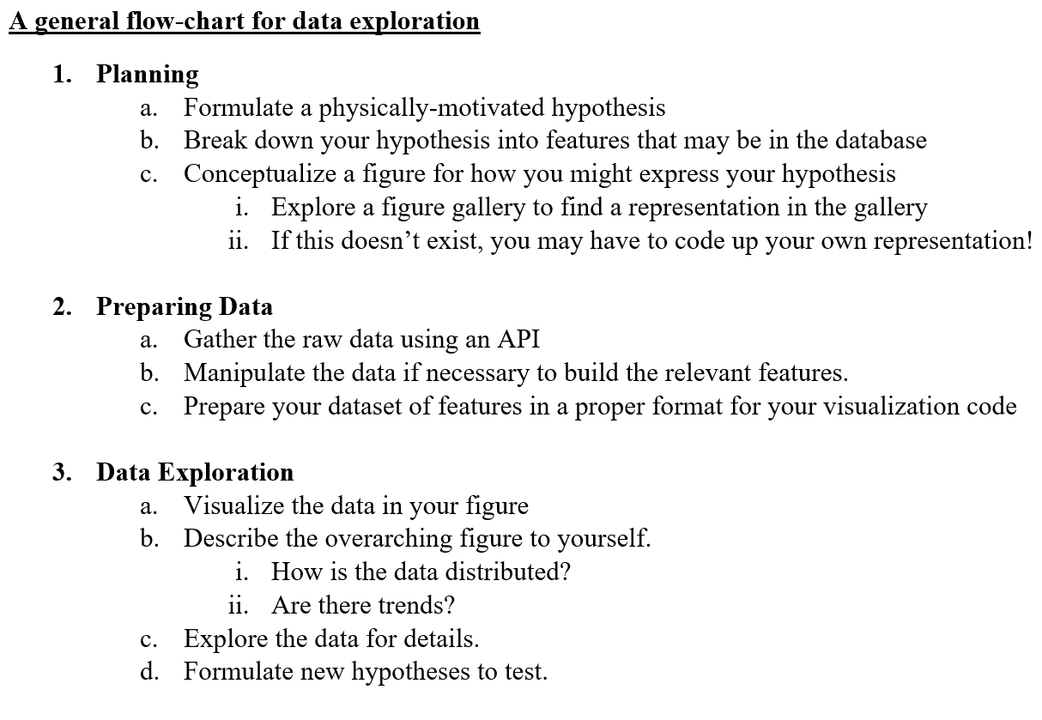

Slide 16
Scroll down on https://wenhaosun.github.io/MSE593/

Slide 17
Python Data Structures: https://docs.python.org/3/tutorial/datastructures.html#dictionaries
Materials Project features available via API: https://github.com/materialsproject/mapidoc/tree/master/materials
MongoDB Query Language: https://docs.mongodb.com/manual/reference/operator/query/
Pandas in 10 minutes: https://pandas.pydata.org/pandas-docs/stable/getting_started/10min.html
Object-oriented programming: Bank Account Example: https://www.geeksforgeeks.org/python-program-to-create-bankaccount-class-with-deposit-withdraw-function/
Pymatgen Composition object: https://pymatgen.org/pymatgen.core.composition.html
Figure Galleries:
Plotly Interactive Figures: https://plot.ly/python/
Matplotlib: https://matplotlib.org/gallery.html
Seaborn: https://seaborn.pydata.org/examples/index.html
Bokeh: https://docs.bokeh.org/en/latest/docs/gallery.html

Slide 18
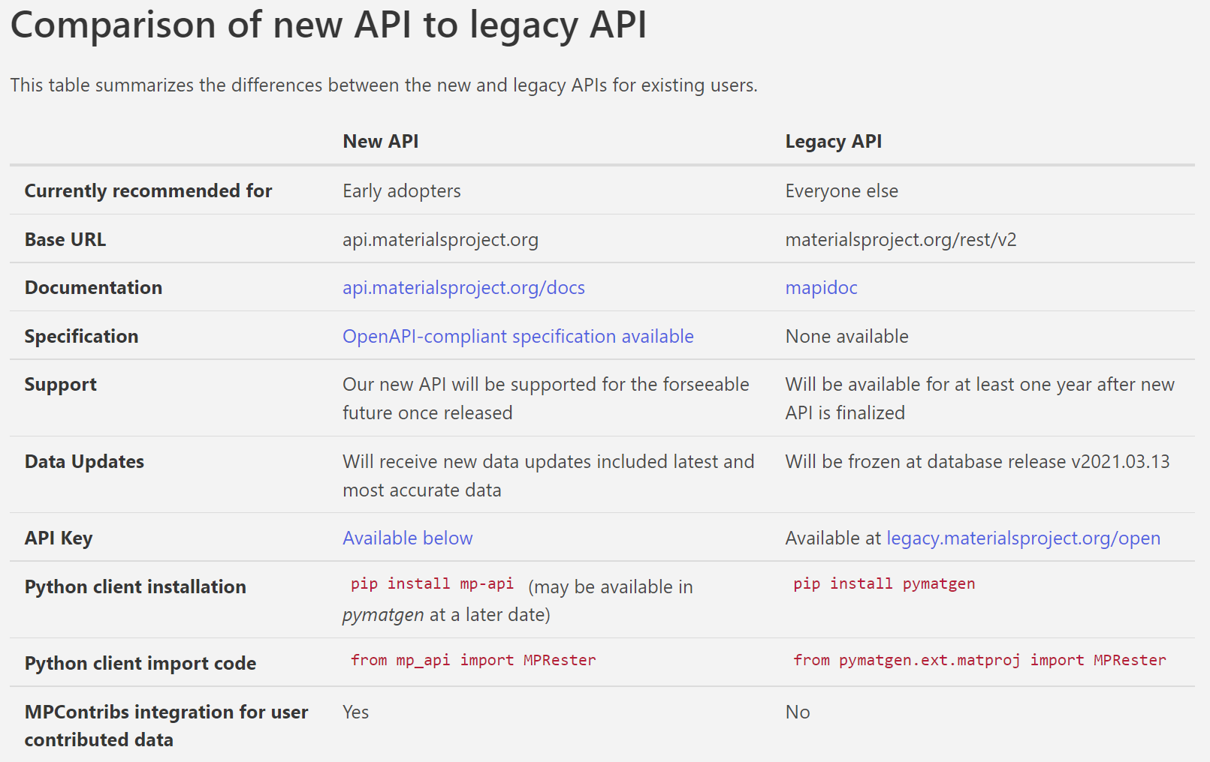

Slide 19
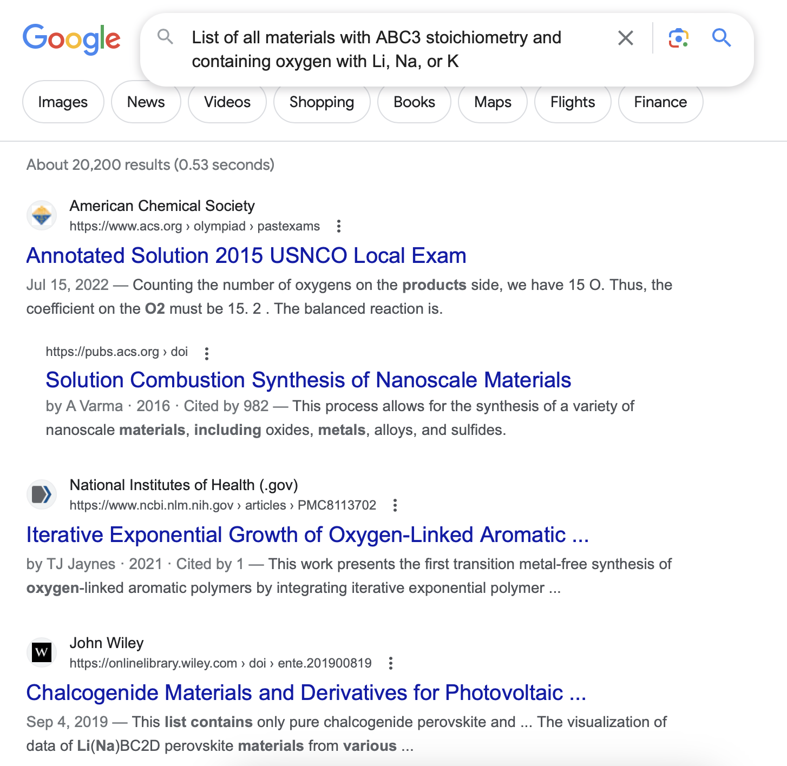
GOOGLE

Slide 20
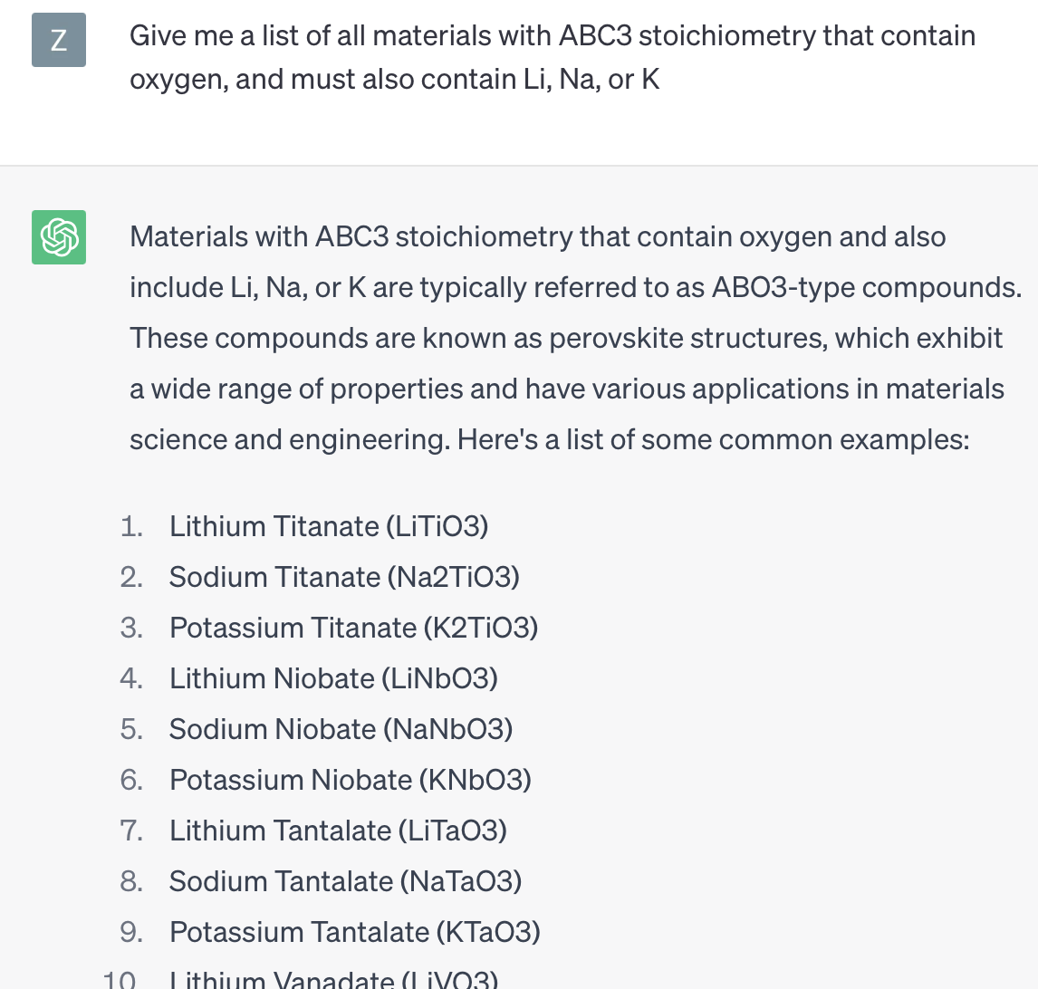
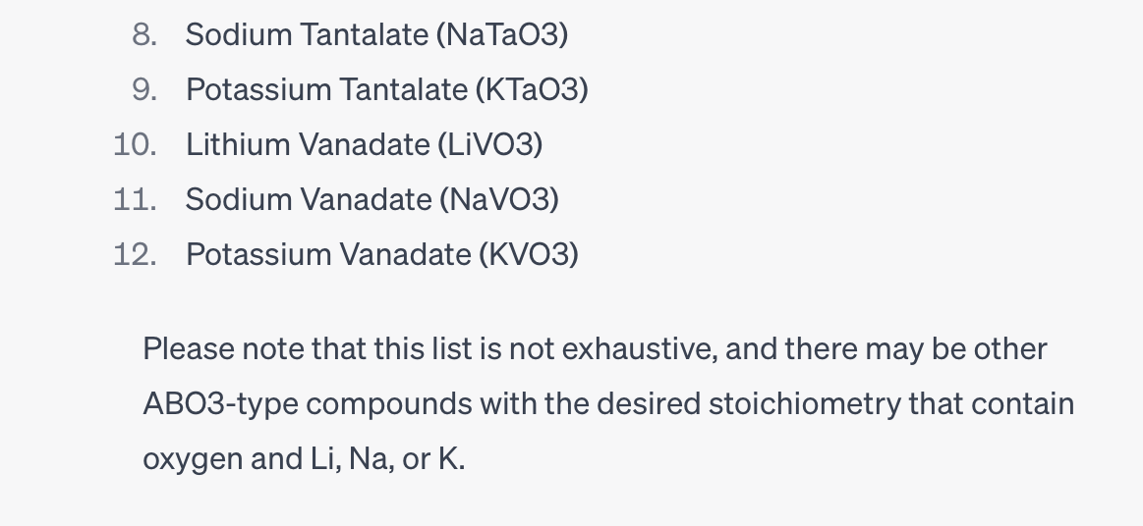
CHAT-GPT

Slide 21
PYMATGEN
Python Code:
criteria = {'elements':{"$in":["Li", "Na", "K"], "$all": ["O"]},
'nelements':3,
'anonymous_formula': {"A": 1, "B": 1, "C": 3} }
props = ['pretty_formula’]
entries = MPR.query(criteria=criteria, properties=props)
for e in entries:
print(e['pretty_formula'])
Mongo Database Format:
Output:
KPO3 LiVO3 LiSbO3 NaTaO3 NaVO3 NaNbO3 NaSbO3 NaTaO3 K3ClO KNO3 KVO3 NaBrO3 LiIO3 KIO3 NaNbO3 NaBrO3 LiIO3 NaNO3 KNO3 LiIO3 NaVO3 KAsO3 LiTaO3 NaNbO3 KSiO3 LiBiO3 KAsO3 Na3ClO NaSbO3 LiNO3 NaZnO3 KPO3 NaPO3 KIO3 LiNbO3 KBrO3 NaNbO3 K3AuO LiIO3 NaSbO3 NaNbO3 KPO3 NaIO3 NaUO3 NaBiO3 KNbO3 LiIO3 KTaO3 LiAsO3 NaClO3 KIO3 KNbO3 NaAsO3 KPO3 KClO3 LiOsO3 KClO3 LiUO3 LiReO3 K3CO KCO3 NaTaO3 NaPO3 KIrO3 LiPO3 KSbO3 KClO3 LiPO3 NaPO3 KCO3 LiAsO3 NaClO3 KTiO3 NaIO3 NaNbO3 NaNbO3 KIO3 NaNbO3 KNO3 NaNbO3 NaOsO3 NaSeO3 LiNbO3 KNO3 LiOsO3 LiTaO3 KSiO3 LiNO3 NaNbO3 NaPO3 NaNbO3 KSO3 KIO3 NaNbO3 LiTaO3 LiPO3 NaIO3 Li3BrO KUO3 LiBrO3 NaPO3 LiIO3 KBiO3 KCO3 NaTaO3 NaNbO3 NaNbO3 NaWO3 NaPO3 KSbO3 NaIrO3 NaSeO3 LiNbO3 KNbO3 KSbO3 KPO3 NaNbO3 K3IO NaCO3 NaClO3 KSO3 NaNbO3 K3BrO KNbO3

Slide 22
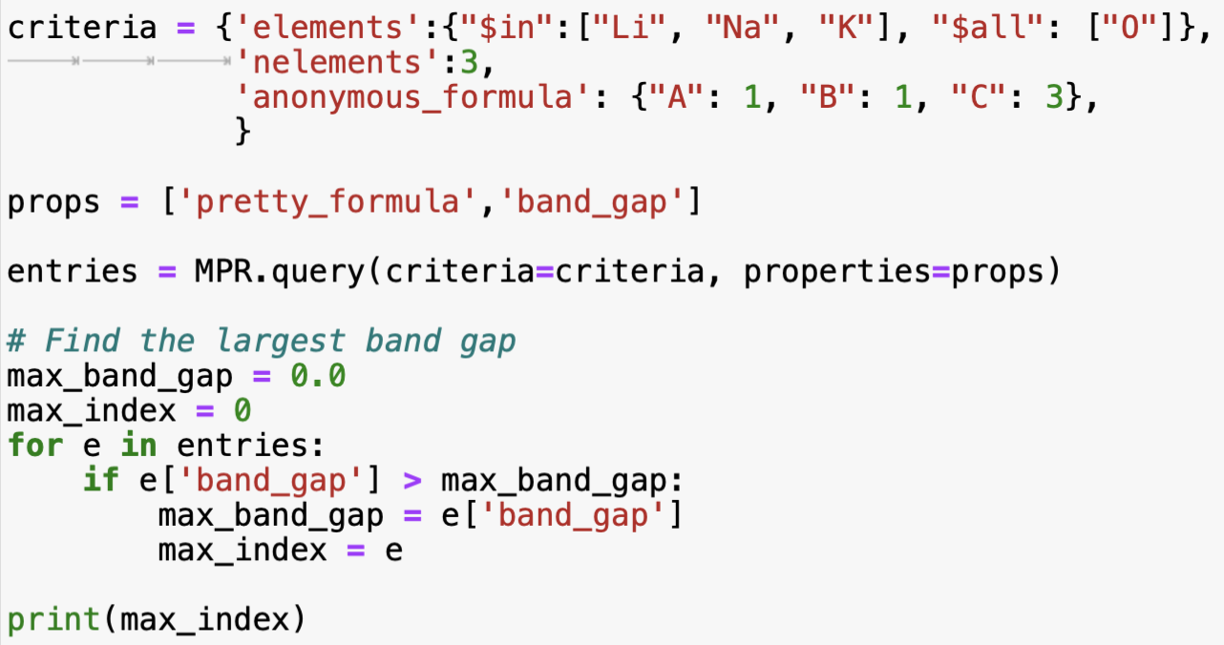
Find Largest Bandgap
Output:

Slide 23
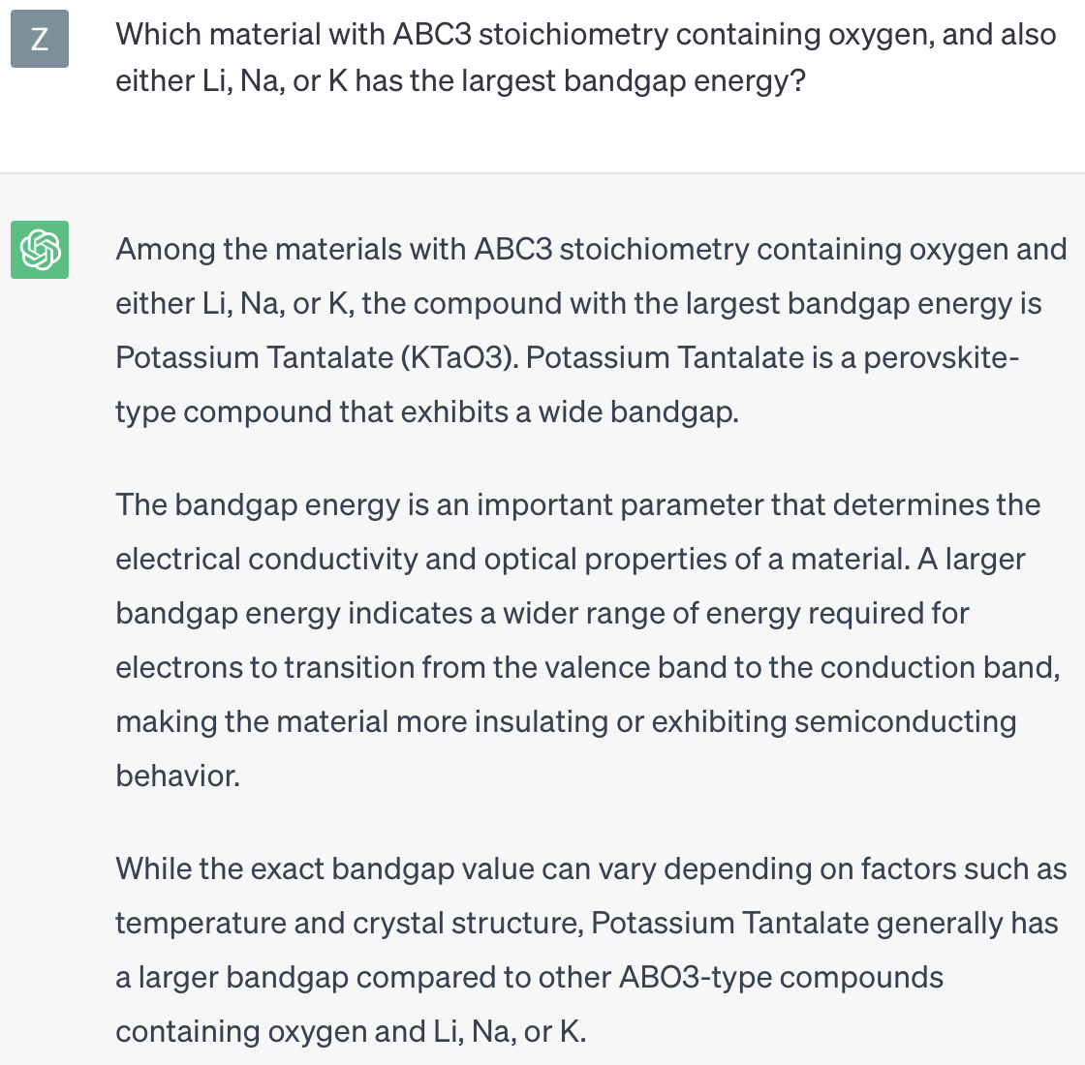
Chat-gpt’s opinion

Slide 24
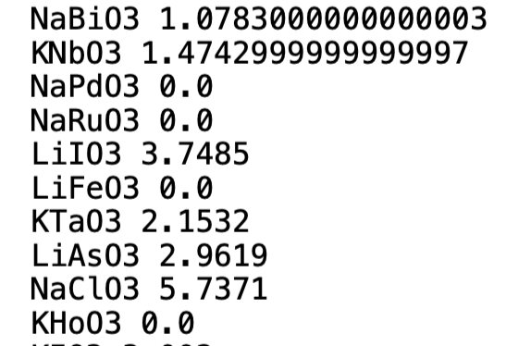
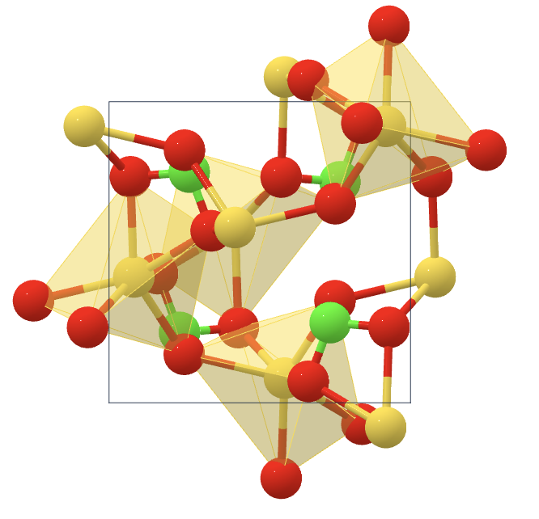
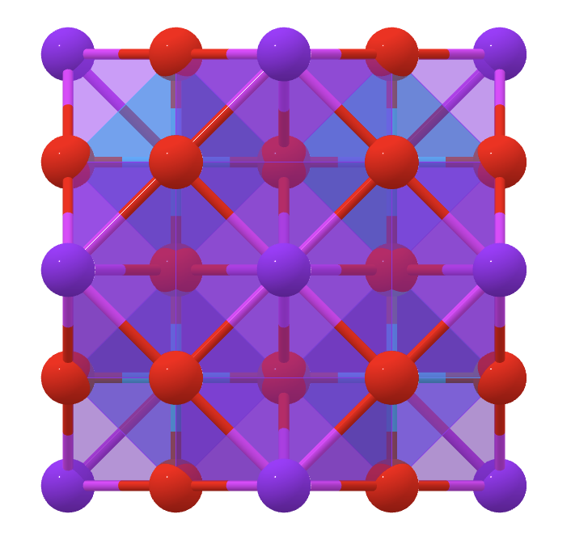
Validation of chat-GPT
Output:
Python Code:
MaterialsProject.org

