Slide 1
Lab 1 Instructions
Below are figures from 16 papers. Your homework is to reproduce these
figures using the MaterialsProject API, Pymatgen, and Visualization code.
For each figure, you will provide a write up with:
A description of your full algorithm. Describe the MP-API features, the pymatgen methods used,
and your visualization process.
The figure itself
One paragraph scientific interpretation of the figure
Separately, attach the python code you wrote.
This is a graduate class. I expect writing quality at a level that you would submit for publication.
You will be graded out of 100 points. You can receive extra credit for any points over 100 at a reduced rate @ 0.25 points per point, and for over 120 points @ 0.1 points per point.
ONLY FIGURES WORTH ≥ 50 POINTS are eligible for extra credit.
Due Tuesday, February 11th, 8:30 AM

Slide 2
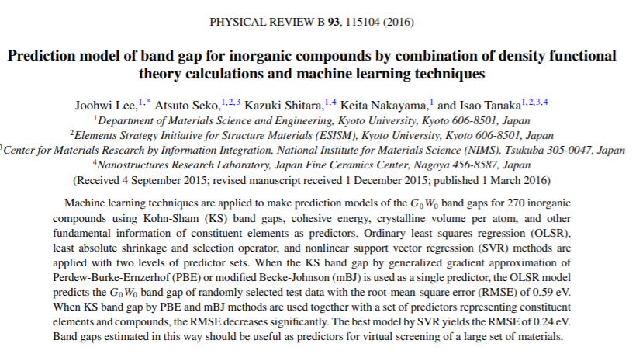
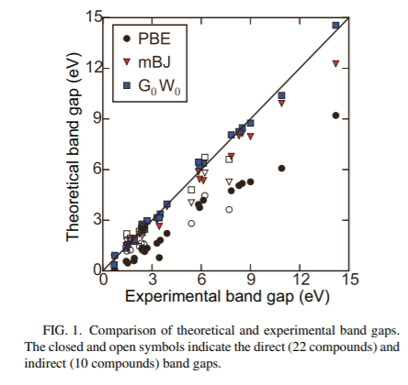
25 points
Experimental data in the paper.
Calculated data must come from MP
Use Plotly to visualize.

Slide 3
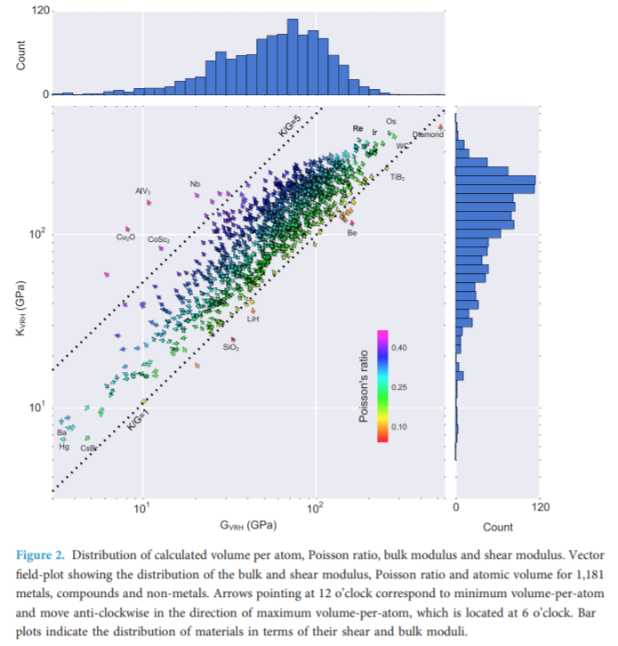
25 points
Seaborn

Slide 4
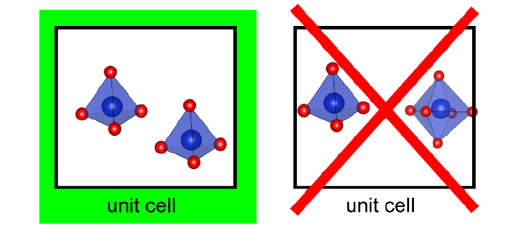
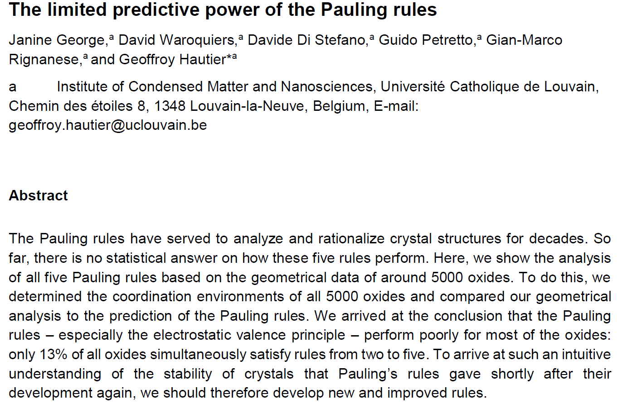
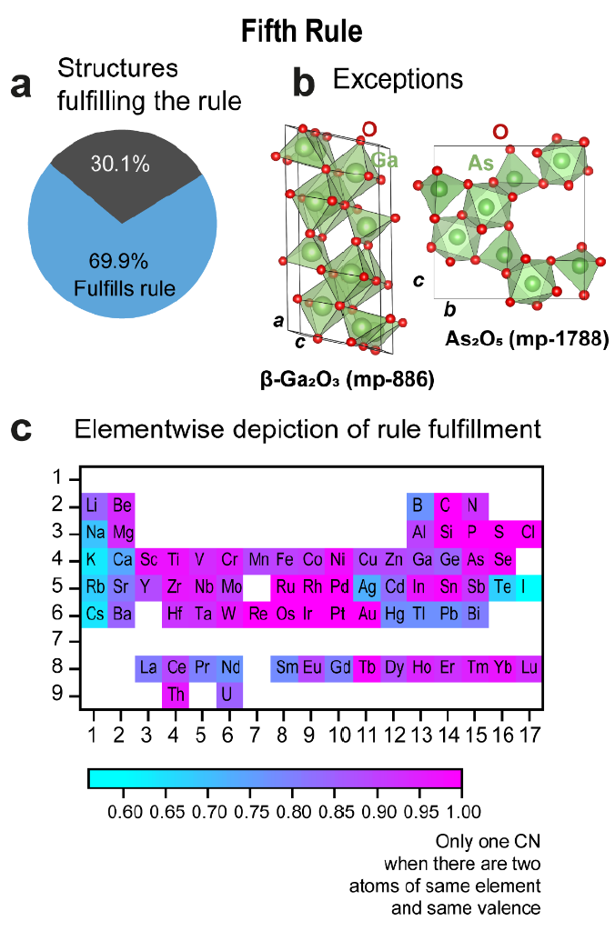
30 Points
pymatgen.core.structure
pymatgen.analysis.structure_analyzer
Bokeh Periodic Table

Slide 5
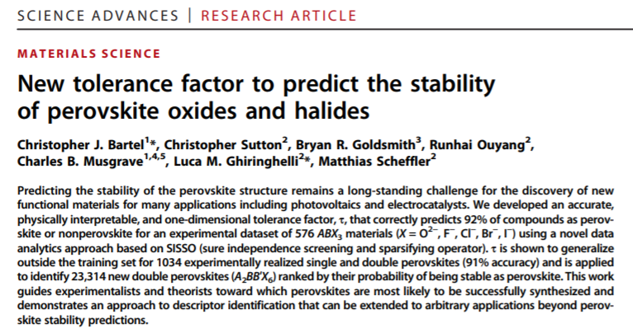
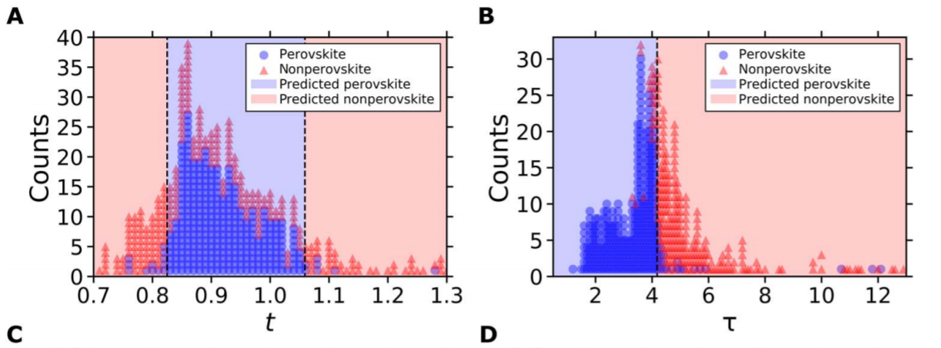
pymatgen.core.structure
pymatgen.core.periodic_table
30 Points

Slide 6
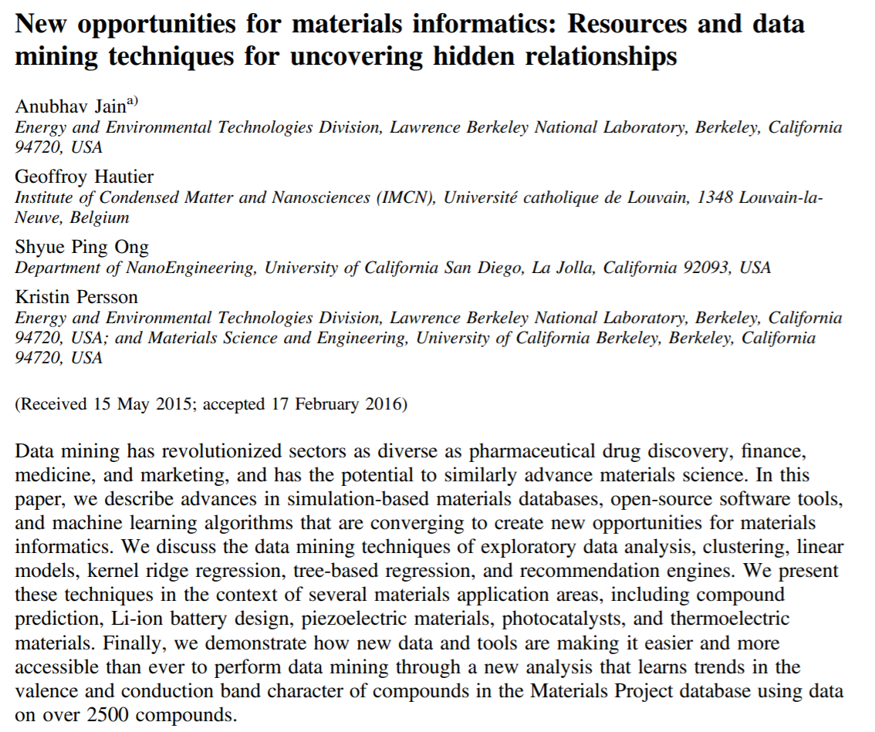
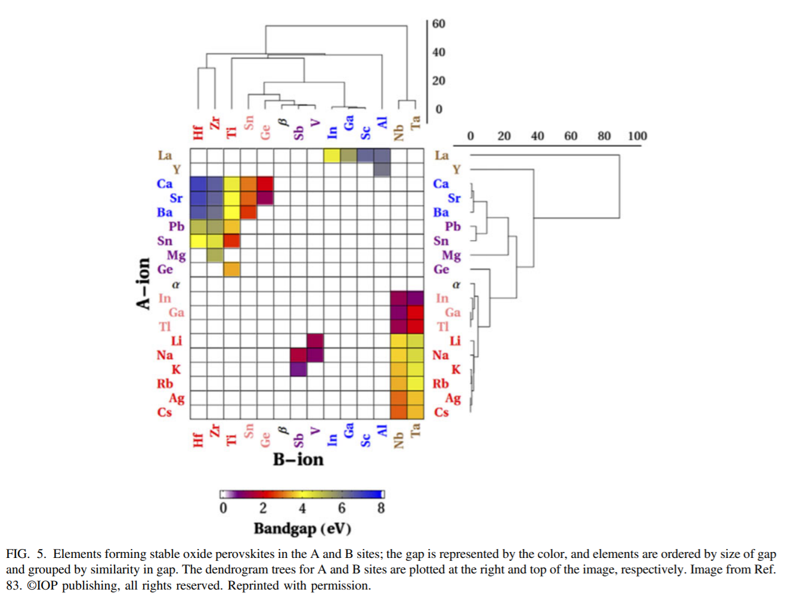
35 Points
Seaborn clustermap
Pymatgen.core.structure

Slide 7
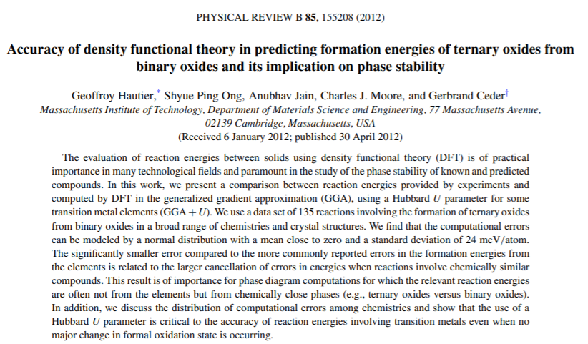
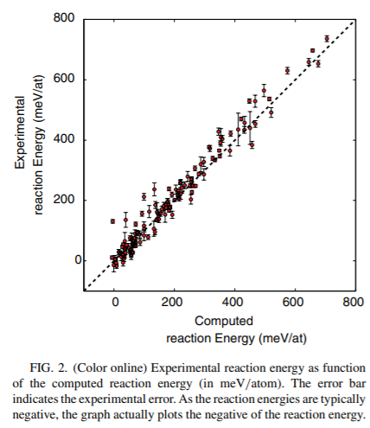
40 points
pymatgen.analysis.reaction_calculator
Experimental data in the paper.
Calculated data must come from MP

Slide 8
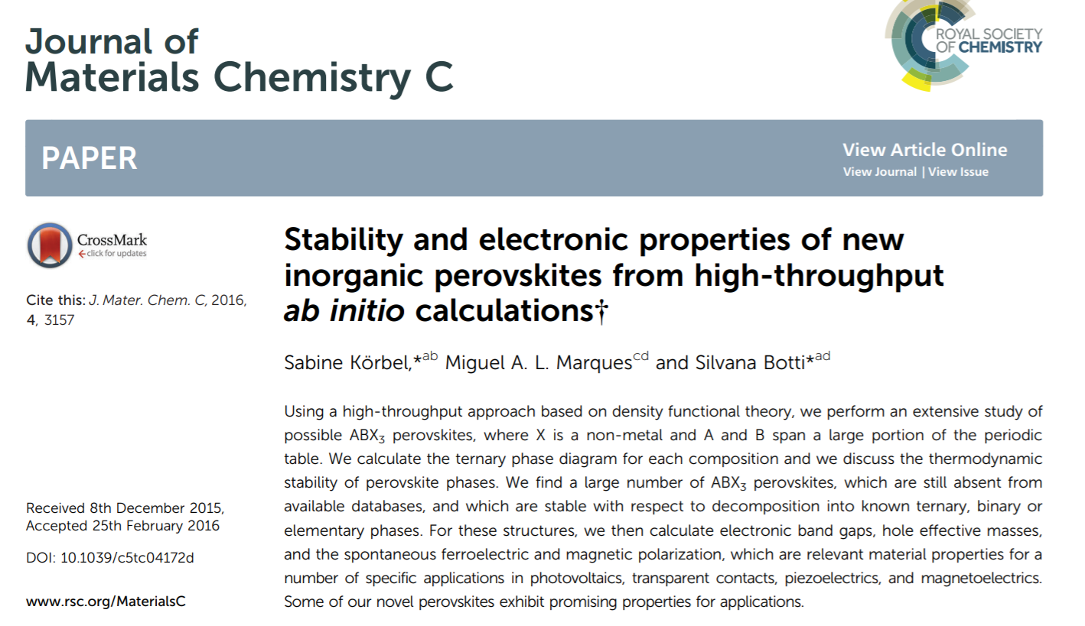
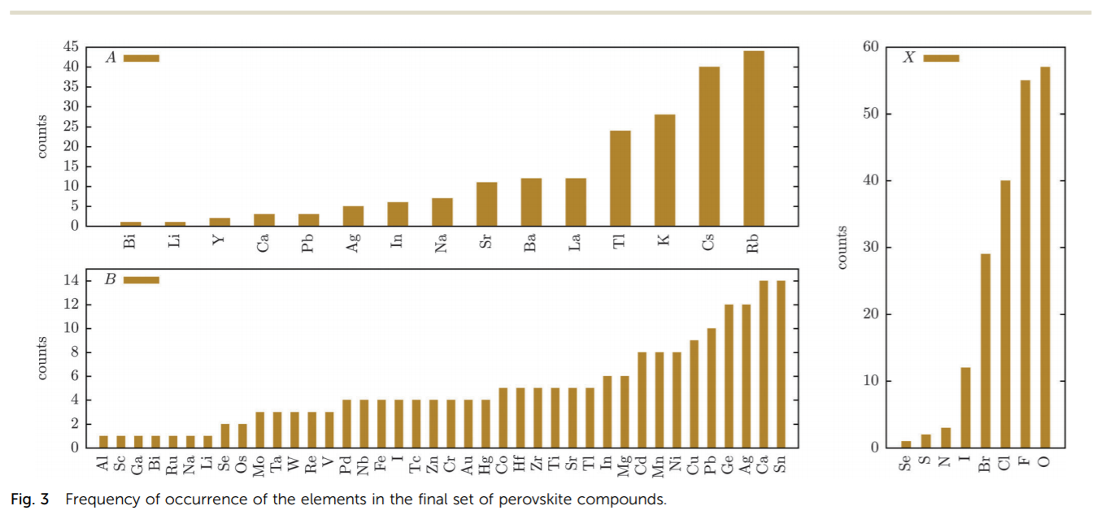
35 points
pymatgen.analysis.structure_matcher
Experimental data in the paper.
Calculated data must come from MP

Slide 9
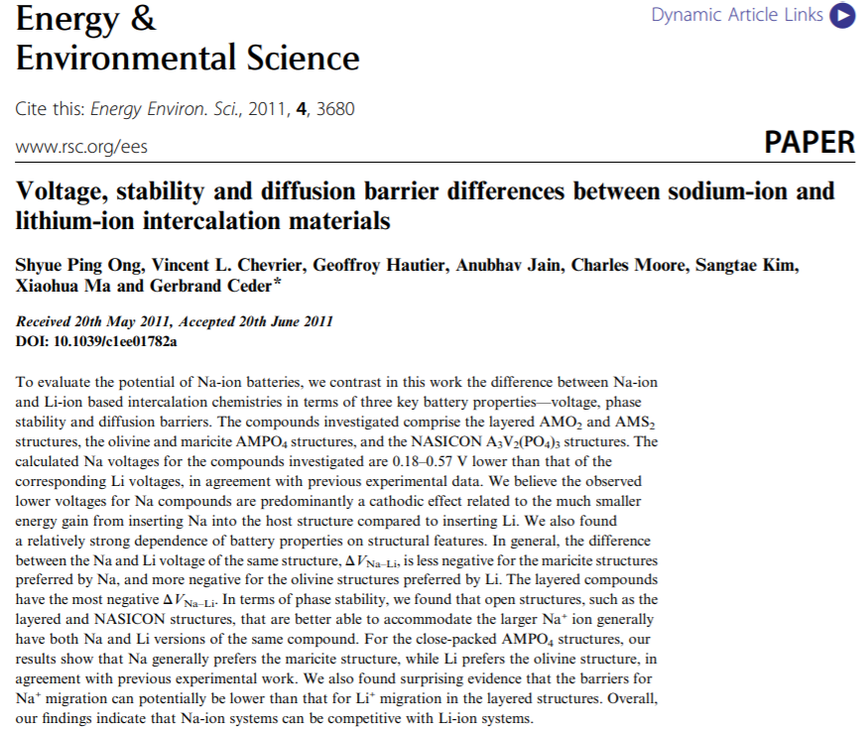
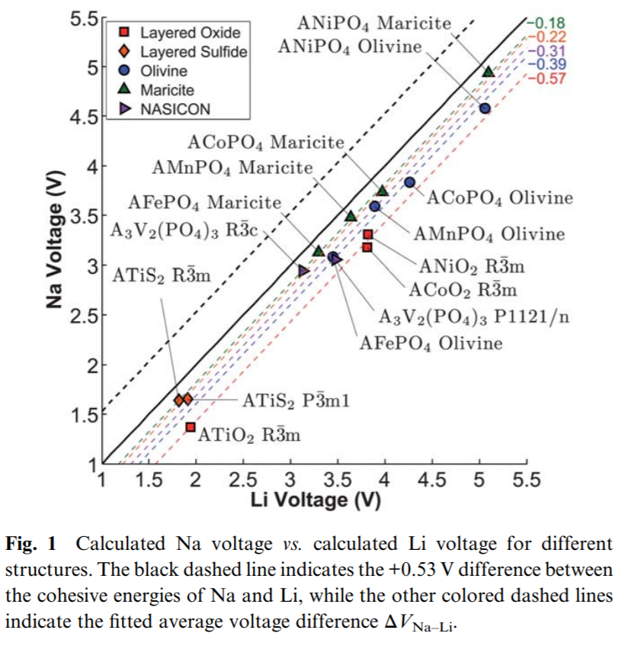
45 Points
pymatgen.analysis.structure_matcher
pymatgen.apps.battery.insertion_battery

Slide 10
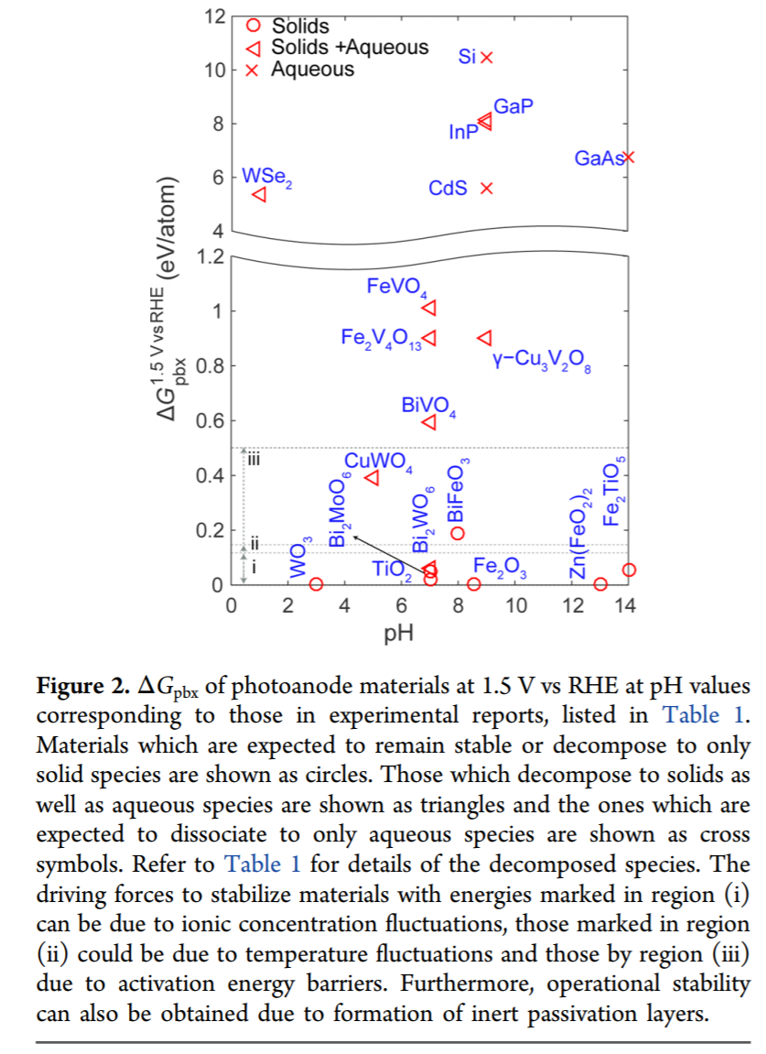
45 Points
pymatgen.analysis.pourbaix_diagram

Slide 11
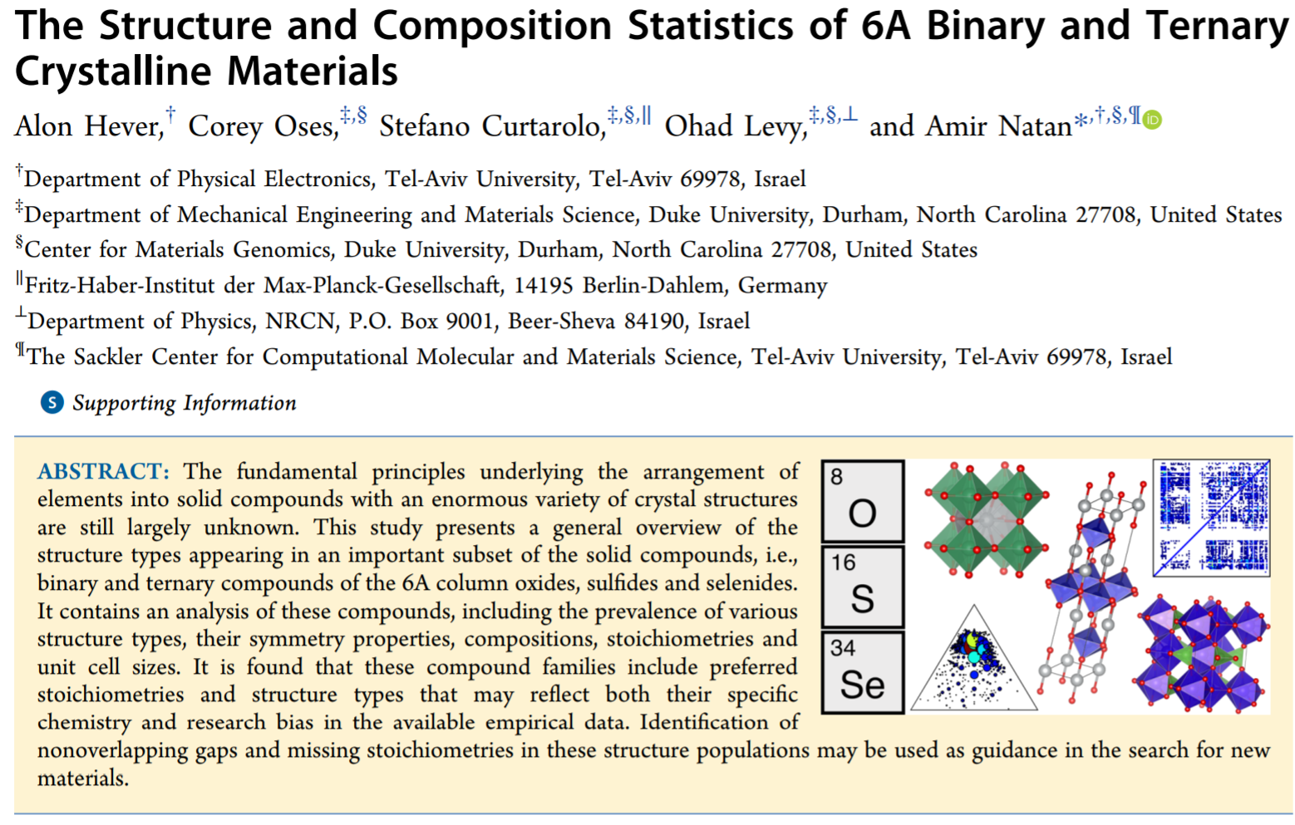
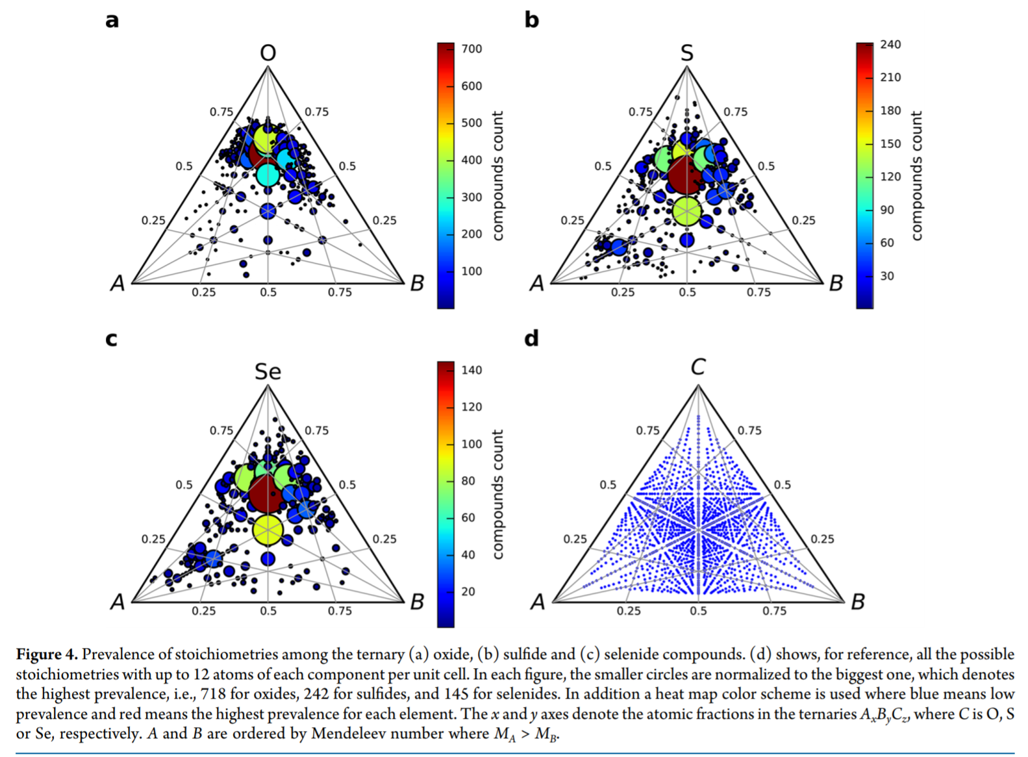
50 points
pymatgen.core.composition
https://github.com/marcharper/python-ternary

Slide 12
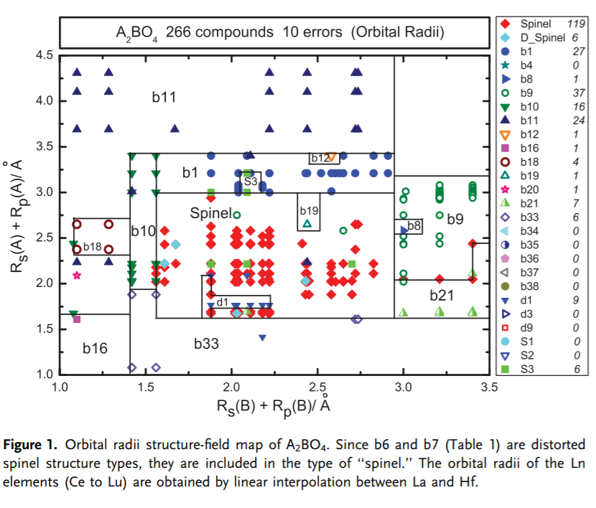
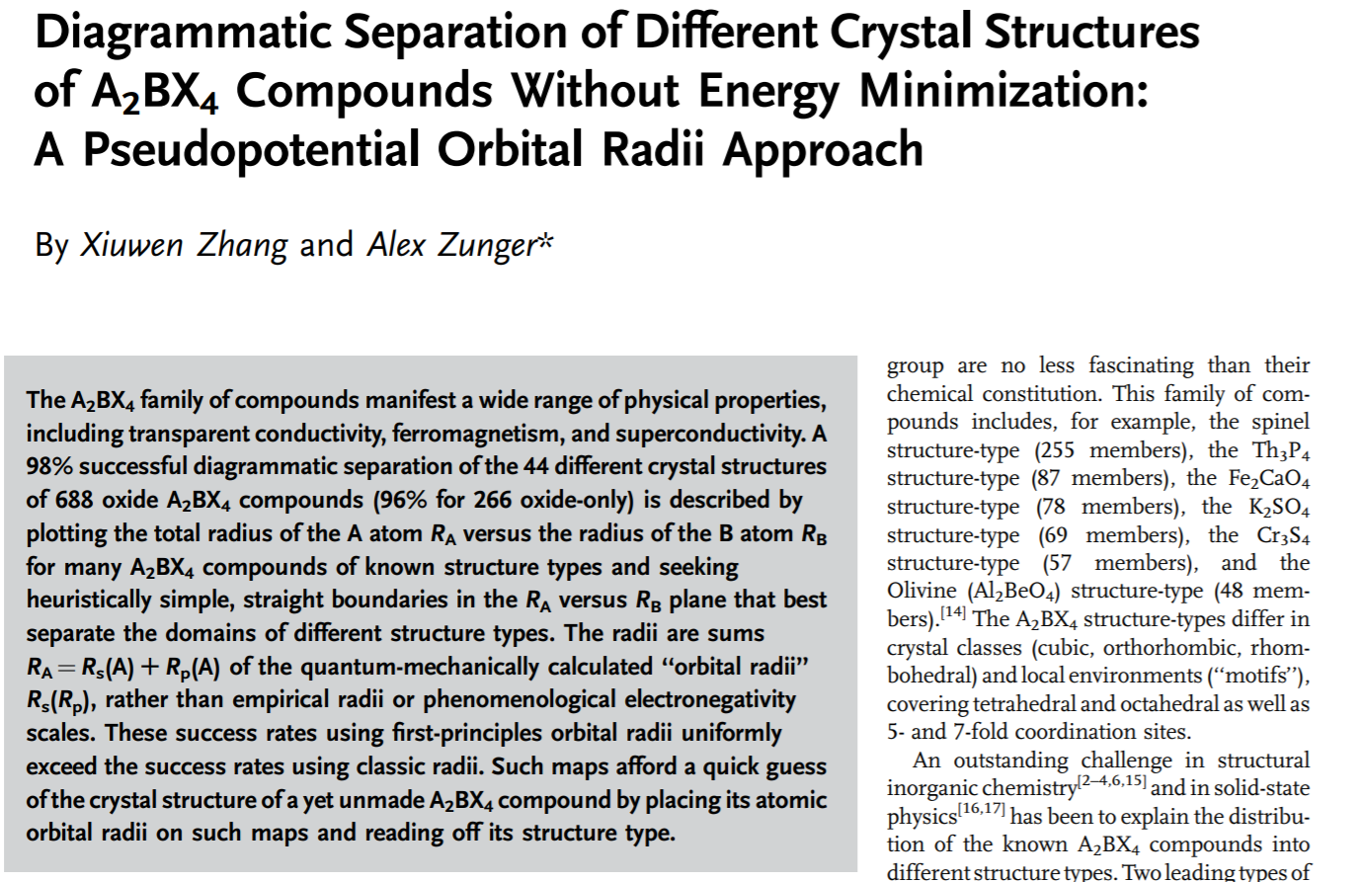
50 Points
pymatgen.core.structure
pymatgen.core.periodic_table
pymatgen.analysis.structure_matcher

Slide 13
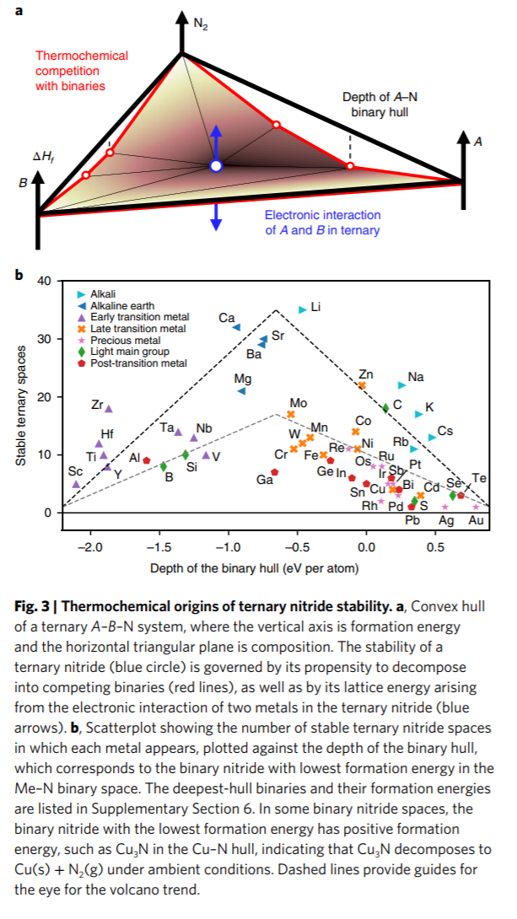
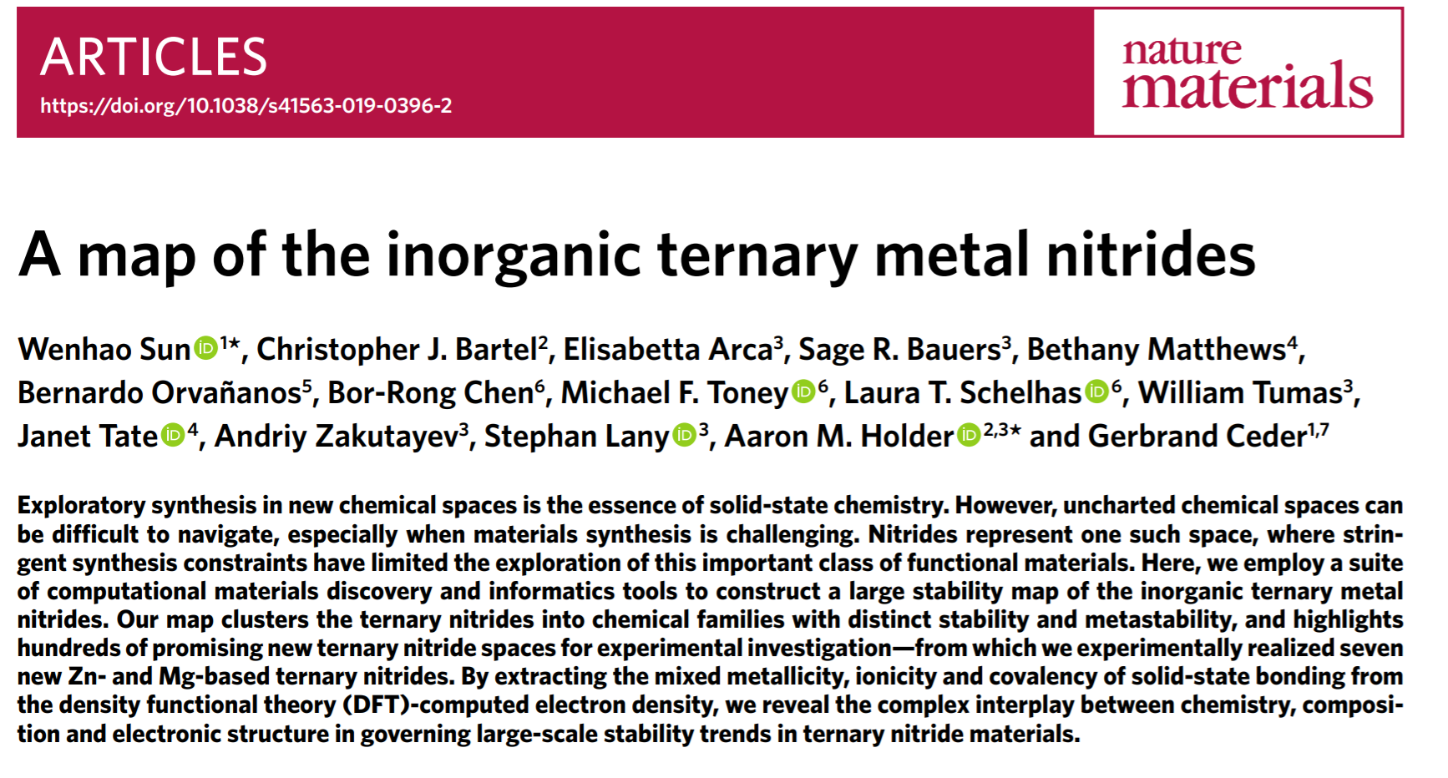
60 Points
pymatgen.analysis.phase_diagram

Slide 14
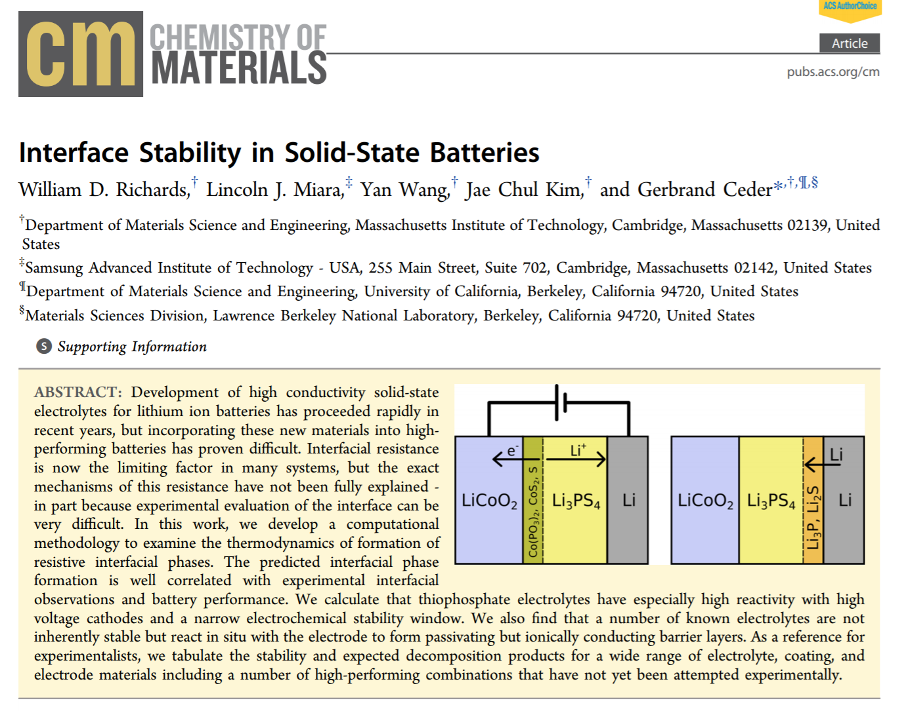
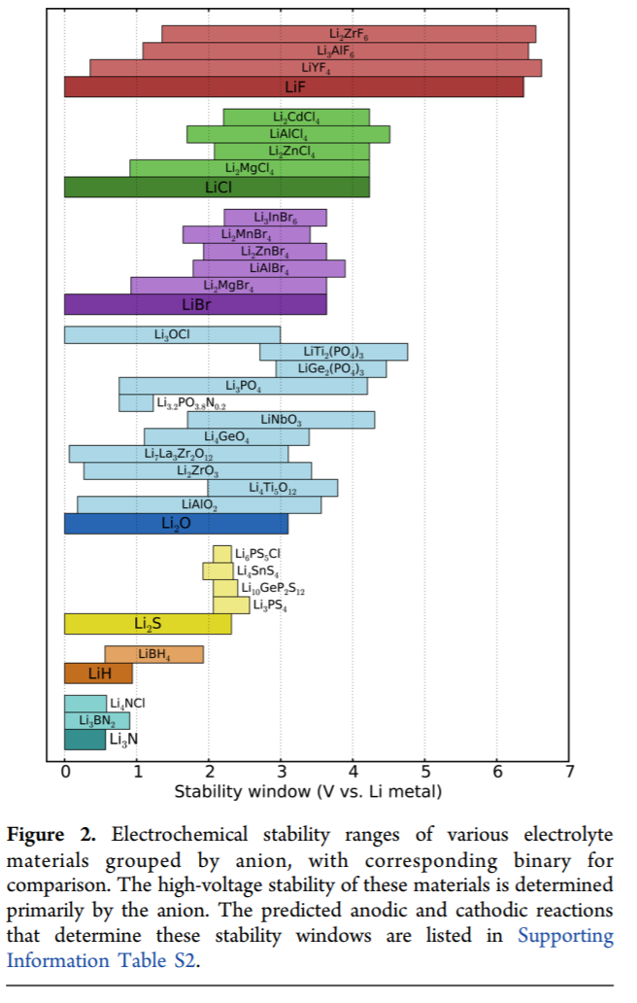
60 Points
pymatgen.analysis.interface_reactions
pymatgen.analysis.phase_diagrams

Slide 15
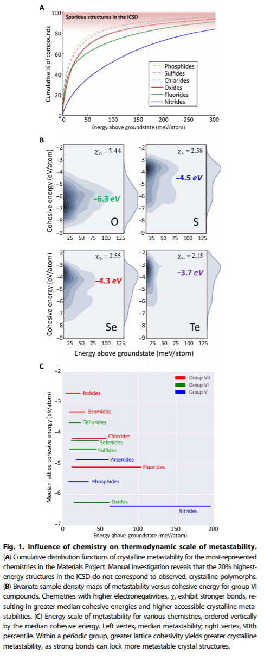
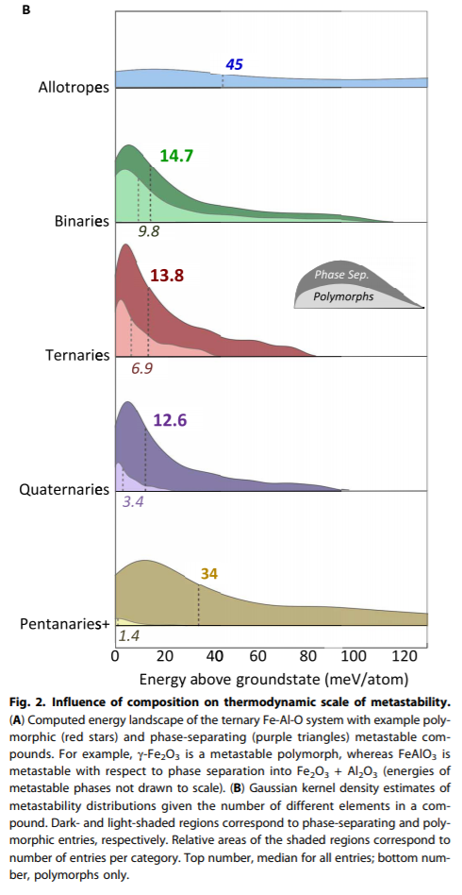
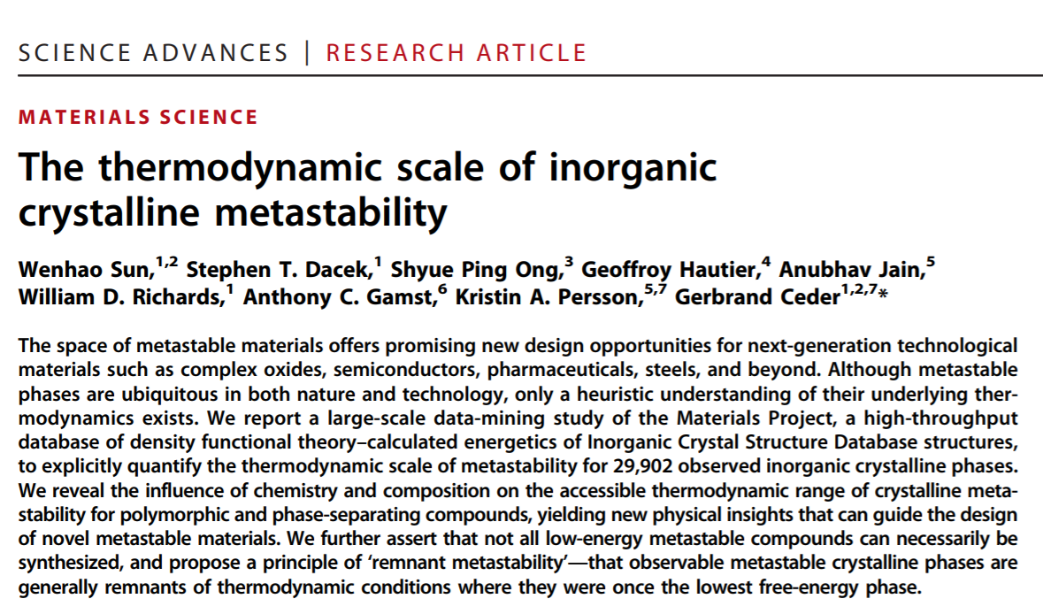
Figure 1. 60 Points
Figure 2. 70 points
pymatgen.analysis.phase_diagram
Seaborn

Slide 16
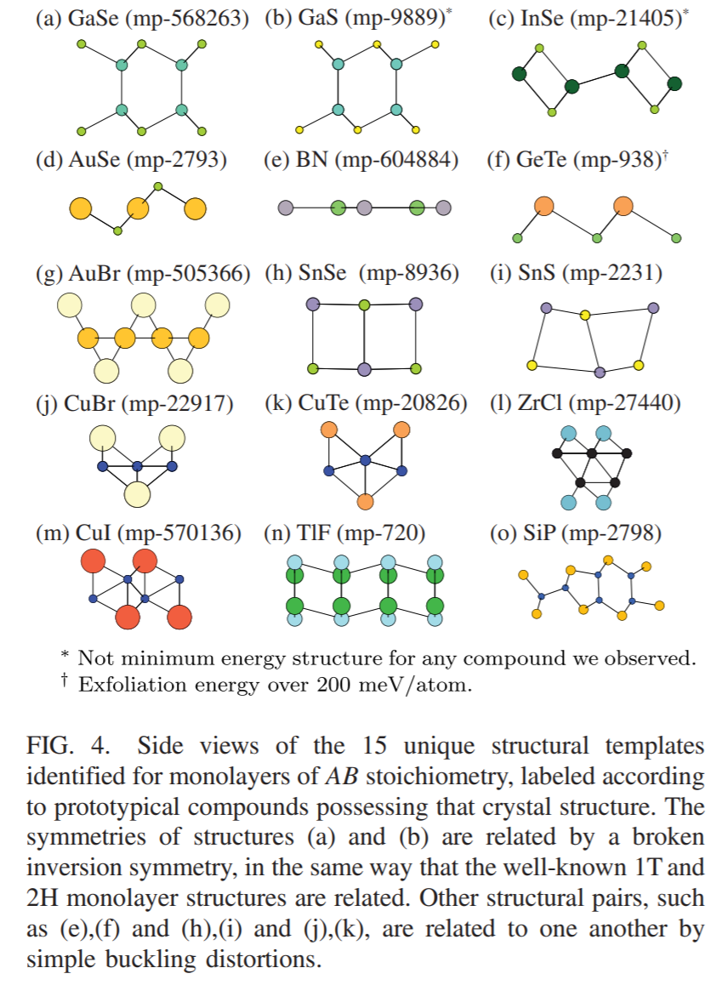
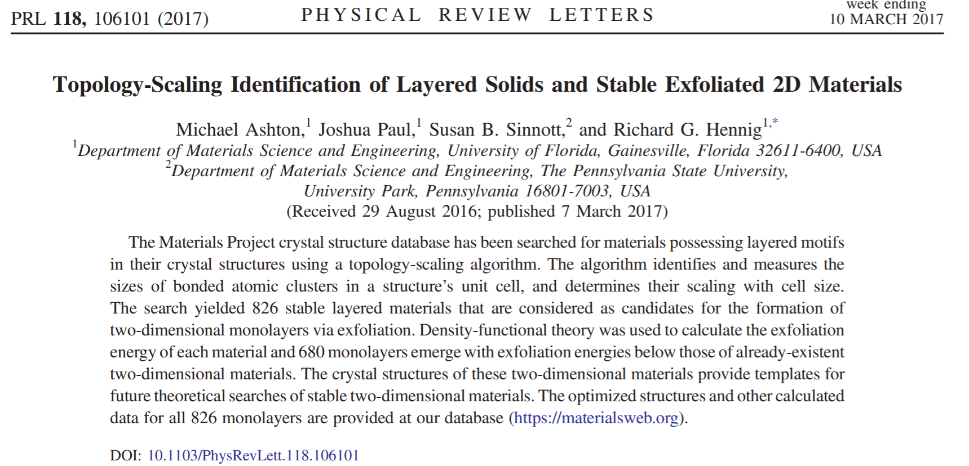
75 Points
pymatgen.core.structure
Pymatgen.core.lattice

Slide 17
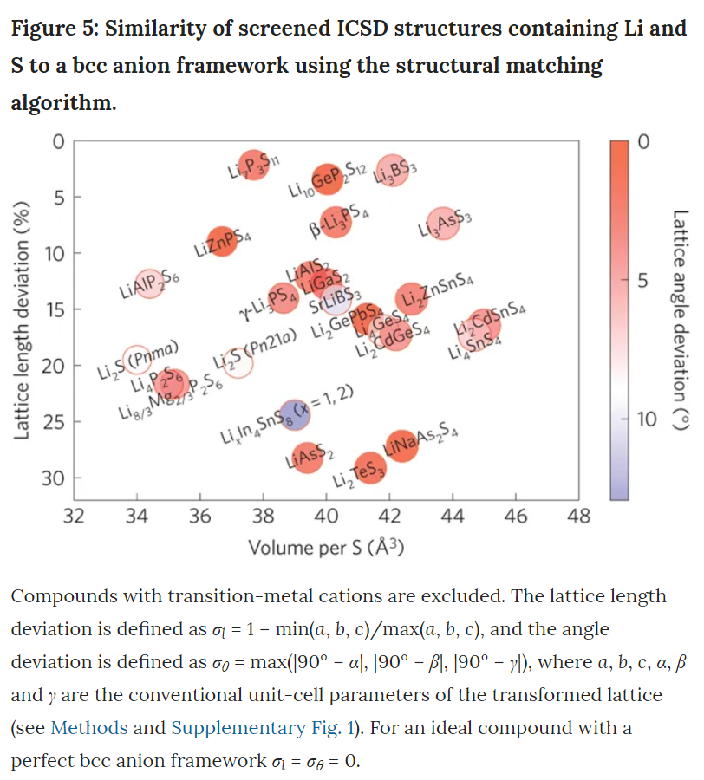
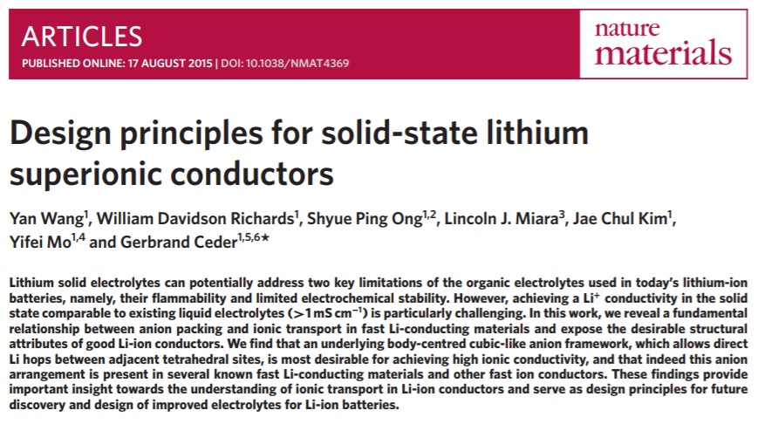
pymatgen.core.structure
pymatgen.core.lattice
pymatgen.analysis.structure_matcher
75 Points

